Slide 1
The Cell Cycle and Mitosis

Slide 2
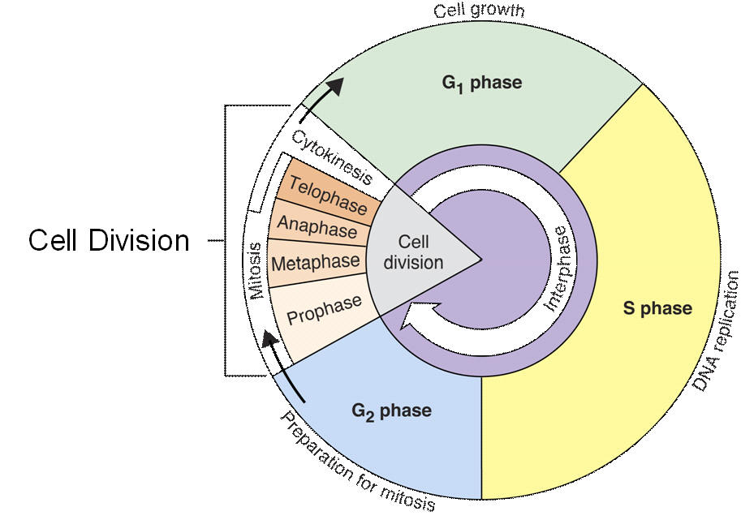
The Cell Cycle

Slide 3
The cell cycle is divided into 3 stages:
Interphase: the longest phase. Divided into 3 smaller stages; G1, S, and G2.
Cell Division/Mitosis (M phase): the division of the nucleus
Cytokinesis: the division of the cytoplasm and the organelles.

Slide 4
Add these notes!
G1 = Gap 1
Cell grows
S = Synthesis
DNA is replicated (synthesized)
G2 = Gap 2
Cell prepares for division
Between each phase are “cell cycle check points.” Proteins check for mistakes in DNA, organelles, and correct them!

Slide 5
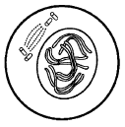
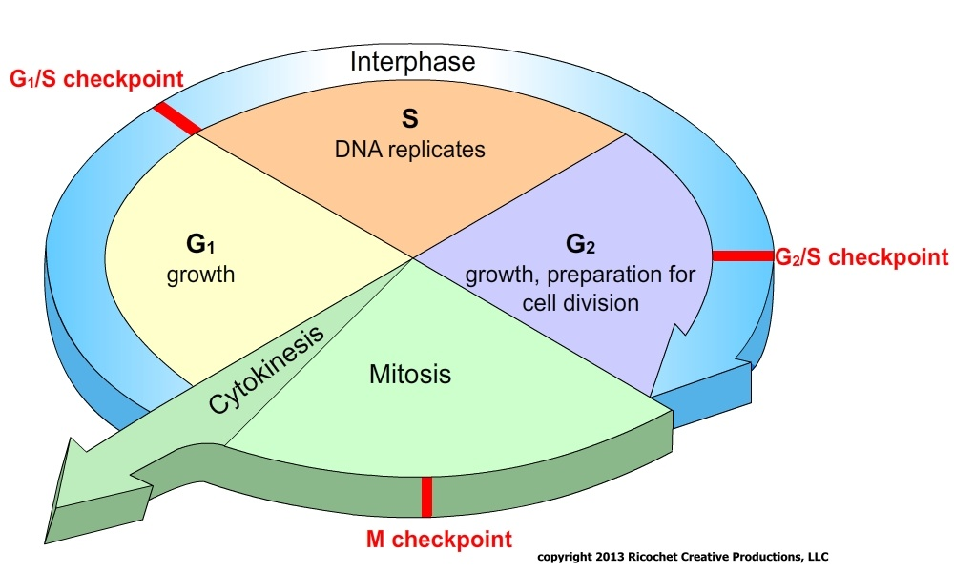
Cell is growing, duplicating DNA and organelles
Centrioles become visible
Chromatin (chromosomes) have duplicated

Slide 6
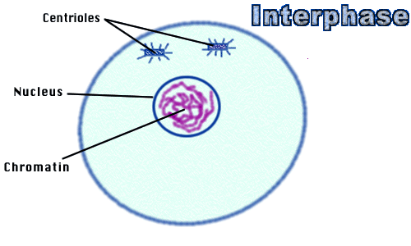
Interphase
Centrioles
Cell is growing, duplicating DNA and organelles
Centrioles become visible
Chromatin (chromosomes) has duplicated

Slide 7
Prophase
Centrioles
Spindle fibers appear
Chromosomes condense (become visible)
Spindle Fibers
Duplicated Chromosomes

Slide 8
Metaphase
Centrioles
Spindle Fibers
Chromosomes line up in the center/middle of the cell on the equator
Chromosomes

Slide 9
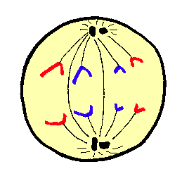
Anaphase
Centromeres divide and sister chromatids move to opposite poles of the cell
Chromatids

Slide 10
Telophase
Nuclear Membrane
2 Nuclear membranes re-form
Chromosomes un-condense
Spindle fibers disappear
Chromosomes

Slide 11
Cytokinesis
Cytoplasm
Cytoplasm and organelles divide
2 daughter cells with identical genetic information (DNA) are produced

Slide 12
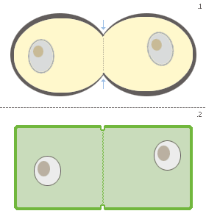
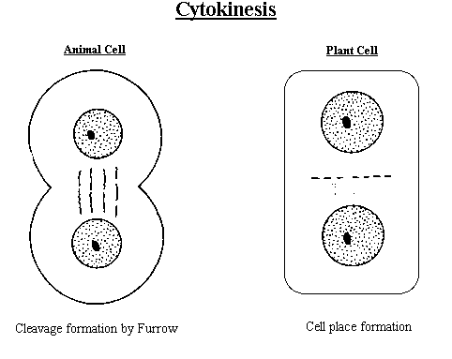
Cytokinesis: Plant vs. Animal Cells
Animal Cells – cells pinch in (a cleavage furrow forms)
Plant Cells – a cell plate that becomes the cell wall

Slide 14
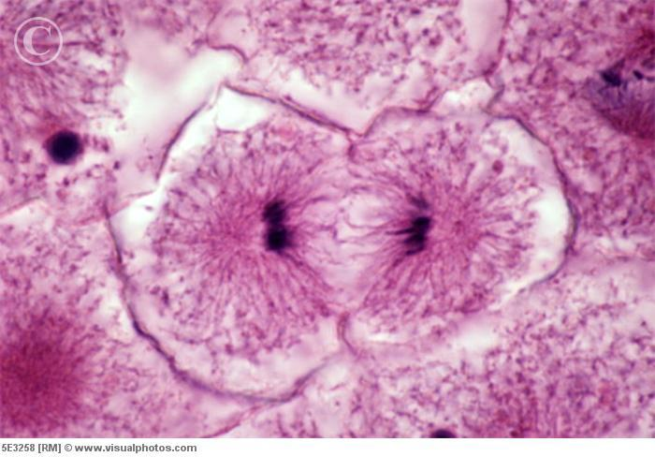
Plant Cell or Animal Cell Cytokinesis?

Slide 15
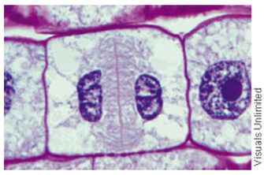
Plant Cell or Animal Cell Cytokinesis?

Slide 16
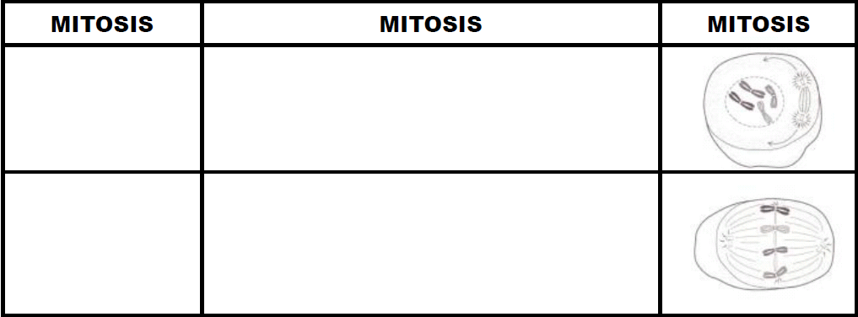
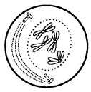
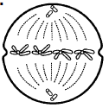
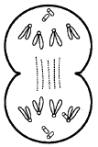
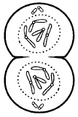
Prophase
Spindle fibers appear
Chromosomes condense (become visible)
Chromosomes line up in the center/middle of the cell on the equator
Metaphase
Anaphase
Centromeres divide and sister chromatids move to opposite poles of the cell
Telophase
2 Nuclear membranes re-form
Chromosomes un-condense
Spindle fibers disappear

Slide 17
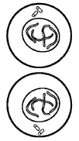
Cytoplasm and organelles divide
2 daughter cells with identical genetic information (DNA) are produced
Animal Cells – cells pinch in
Plant Cells – a cell plate that becomes the cell wall
ADD THIS AT THE BOTTOM!
Types of cells that can divide by mitosis include SOMATIC CELLS (= body cells; such as muscle, skin, bone, roots, etc)
Why do cells divide by mitosis? 1) Asexual Reproduction 2) Growth 3) Tissue Repair

Slide 18
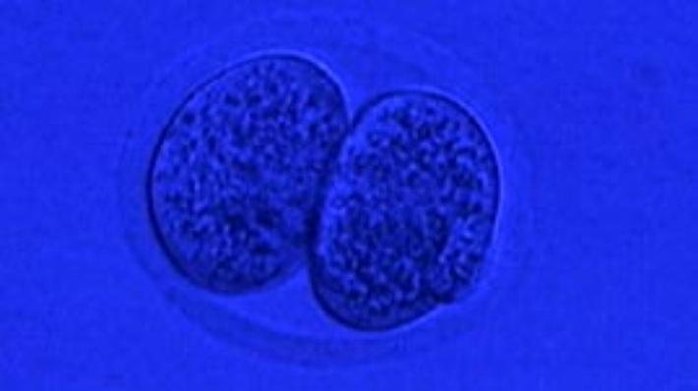
“Mitosis” – PBS Learning Media pbslearningmedia.org

Slide 19
Key Points of Mitosis
What is MITOSIS? | Type of asexual cell division The division of the nucleus in a eukaryotic cell
What is the PURPOSE of mitosis? | GROWTH of organisms REPAIR of cells/tissues ASEXUAL reproduction
What TYPES OF CELLS divide by mitosis? | Somatic (body cells) of plants and animals - Examples: skin, muscle, leaves, roots, yeast, bone - Non-examples: sex cells like sperm, eggs, and pollen 2. Amoebas and other single celled organisms.

Slide 20
How MANY DIVISIONS are involved? (how many times does the cell divide?) | Only 1
HOW MANY CELLS are produced? (How many daughter cells are made?) | 2 genetically identical copies (clones)
What are the CHROMOSOMES like in the daughter cells of mitosis? | Identical to the parent chromosomes in number and in DNA sequence (genes) No genetic variation (all the DNA is the same!)

Slide 21
What happens BEFORE MITOSIS begins? | The DNA is replicated (copied)
What happens when mitosis goes UNCONTROLLED? | Uncontrolled or unregulated cell division results in cancer.
What is the ONLY way to produced cells with GENETIC VARIATION by mitosis? | Only if a mutation (mistake) occurs during DNA replication.

Slide 22
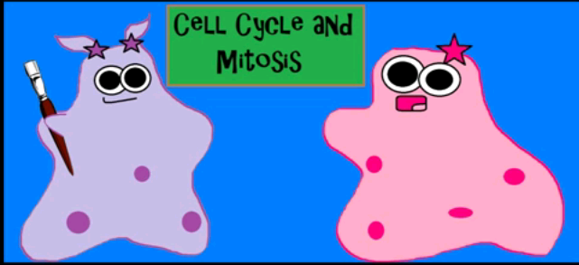
Amoeba Sisters – Cell Cycle and Cancer

Slide 23
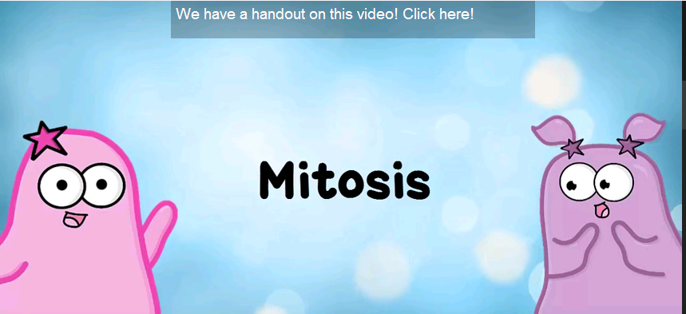
Let’s Review with the Amoeba Sisters!
Watch “ Mitosis: the Amazing Cell Process that Uses Division to Multiply” and complete the handout.

Slide 24
Mitosis Math
When a somatic cell (body cell) reproduces asexually by mitosis, the parent cell produces daughter cells with the same number of chromosomes as the parent cell. This number is said to be “diploid” (2n). In humans, for example, a skin cell has 46 chromosomes. So, the diploid number of chromosomes is 46. When a skin cell divides by mitosis during asexual reproduction (like to repair a cut), how many chromosomes will the 2 new skin cells each have? _____ (Remember, mitosis produces clones! Identical copies!)

Slide 26
Math Practice!
A) If an amoeba (protist) parent cell has 14 chromosomes, then what is its diploid chromosome number? ______
B) How many chromosomes will the daughter cells of the amoeba have if it divides asexually? ____
C) A plant root cell has a diploid chromosome number of 24. How many chromosomes will each of its daughter cells have if it reproduces by mitosis? ____
D) If a dog cell has 72 chromosomes, how many daughter cells will be created during a single cell cycle? ____

Slide 27
Mitosis Quick Check!
) Why is the DNA replicated before a cell goes through mitosis?
) What would happen if the cell did not replicate its DNA?
) Why does the daughter cell not contain 52 chromosomes?
) What kinds/types of cells would go through mitosis?
) What purpose would living things have for mitotic division?

Slide 28
Mitosis Video
In the time it took you to watch this video clip, you lost 40,000 skin cells, yet you are not skinless. How does the information contained in the video clip explain why this is so?
http://wtvi.pbslearningmedia.org/resource/tdc02.sci.life.stru.dnadivide/mitosis/

Slide 29
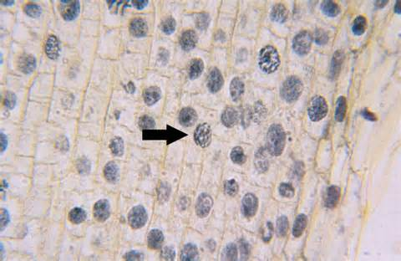
Example of 1 cell:

Slide 30
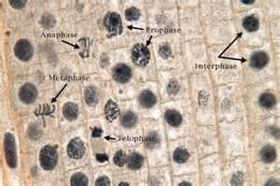
Examples:

Slide 31
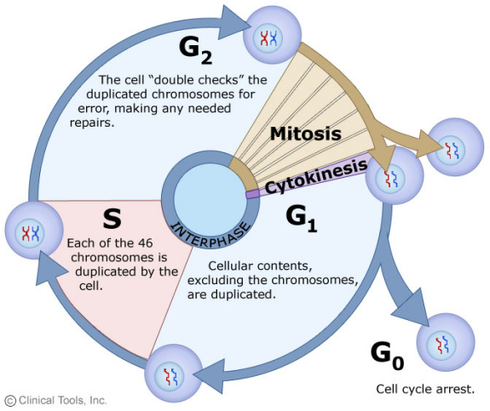
Use with your Warm-up:

