Slide 3
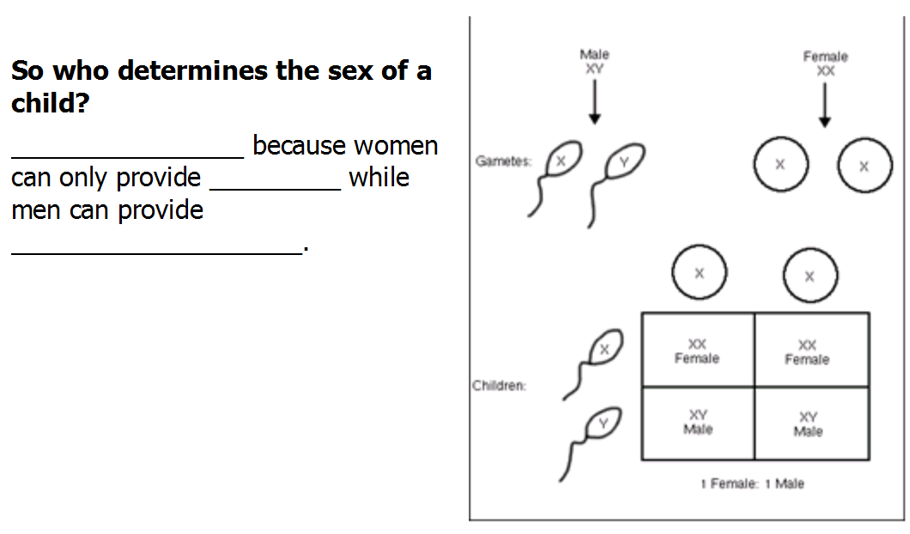
Males
Xs
X or Y

Slide 4
genes
sex
RECESSIVE
Males
1
CARRIERS
normal

Slide 5
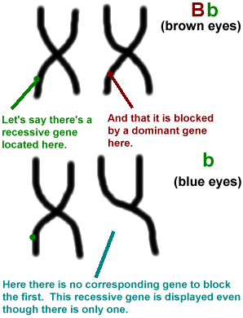
HEMOPHELIA
COLORBLINDESS (red-green)
Calico coat color
eye

Slide 6
Males only have 1 X chromosome and cannot be heterozygous
sons
yes

Slide 7
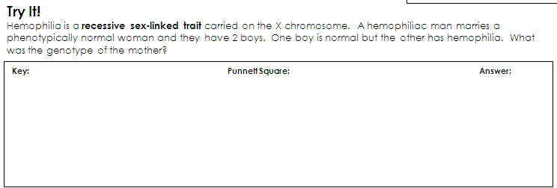

Slide 8
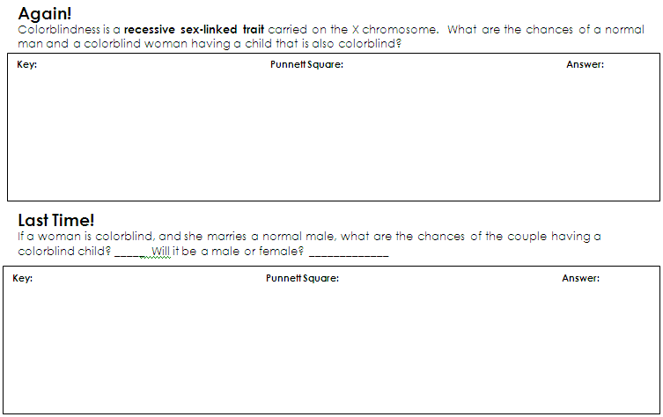

Slide 9
Sex-Linked Traits Worksheet
Background Information:
Sex-linked traits are those whose genes are found on the X chromosome but not on the Y chromosome. In humans the X chromosomes are much larger than the Y chromosome and contains thousands of more genes than the Y chromosome. For each of the genes that are exclusively on the X chromosomes, females, who are XX, would obviously have two alleles. Males, who are XY, would have only one allele. Thus females with one recessive allele and one dominant allele, for a gene that is unique to the X chromosome, will always display the dominant phenotype. However, a male with a recessive allele for a gene unique to the X chromosome will always exhibit that recessive trait because there is no other corresponding allele on the Y chromosome.
In humans, each of two different sex-linked genes has a defective recessive allele that causes a disease. The diseases are hemophilia and colorblindness. In hemophilia, the defective allele prevents the synthesis of a factor needed for blood clotting. In colorblindness, the defective allele prevents a person from seeing certain colors.

Slide 10
Use the information below to answer the following questions.
X^{H}- X chromosome with normal dominant allele (no hemophilia)
X^{h} - X chromosome with recessive hemophilia allele
Y - Y chromosome (does not contain comparable gene)
X^{B} - X chromosome with normal dominant allele (not colorblind)
X^{b} - X chromosome with recessive colorblind allele
Y -Y chromosome (does not contain comparable gene)

Slide 11
Practice!
Use your notes if needed.
Complete the practice sheet on Sex-linked traits.
Check answers at the SSS!

Slide 12
Who Get’s the Money?
This is a Competition!!!
I will not answer questions. Read carefully!
Show ALL your work to receive credit.
There are 3 parts. As you complete each part, bring it to me (with your name on it) and receive the next part.
First 5 People to complete the mystery correctly (with ALL work shown) wins a __________________.

