Slide 1
RELOOPING Ecology & Human Impact
MYP Biology Directions:
Option 1:
Download and print the PPT slides.
Answer all the questions by writing in the answers on the “A” side.
Turn in paper version to your teacher on the day you are ready to re-test.
Option 2:
Download and type in answers into the PPT presentation under “Side A”.
Email your completed version to your teacher. Title the document: “last name_first name_ecology relooping”
Come take a re-test.
Standard Biology Directions:
Answer all the questions by writing in the answers on the “A” side.
Turn in to your teacher on the day you are ready to re-test.

Slide 2
1) Place the following ecological levels of organization in order from smallest(1) to largest(6).
TEAM A
___ SPECIES
___ BIOSPHERE
___ POPULATION
___ COMMUNITY
___ INDIVIDUAL
___ ECOSYSTEM

Slide 3
2) Which interaction (A, B, C, D) is commensalism?
TEAM A
TEAM B

Slide 4
3) Which interaction (A, B, C, D) would be represented by bee and flower?
TEAM A

Slide 5
4) What type of growth is seen at letter B?
TEAM A
TEAM B

Slide 6
5) Which letter represents the point at which the population has reached its carrying capacity?
TEAM A
TEAM B

Slide 7
6) Which letter represents where resources are in unlimited supply?
TEAM A
TEAM B

Slide 8
7) Where on this graph is birth rate higher than death rate?
TEAM A
TEAM B

Slide 9
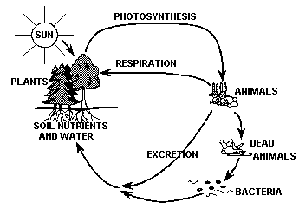
8) List 2 abiotic factors in the ecosystem to the left.
TEAM A
TEAM B

Slide 10
9) Tell whether each organism listed below is an autotroph (A) or a heterotroph (H):
TEAM A
Tree: ____
Worm: ____
Human: ____
Algae: ____
Mushroom (decomposer): ____
Rabbit: ____

Slide 11
10) What is the carrying capacity of the Tasmanian Sheep?
TEAM A
1 million
1.75 million
2 million
2.5 million

Slide 12
11) How much energy would be available to the primary consumers?
TEAM A

Slide 13
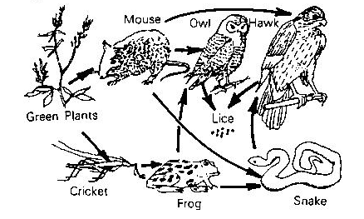
12) Which organism/population has the least biomass?
TEAM A
TEAM B

Slide 14
13) Which organism/population has the greatest amount of available energy?
TEAM A
TEAM B

Slide 15
14) Which organism is a competitor of the snake?
TEAM A
TEAM B

Slide 16
15) A) Which organism occupies the same trophic level as the mouse? B) What trophic level is it?
TEAM A
TEAM B
A)
B)
A)
B)

Slide 17
16) Which process(es) to PRODUCERS perform?
TEAM A
TEAM B

Slide 18
17) Which process(es) convert atmospheric carbon into an organic solid?
TEAM A
TEAM B

Slide 19
18) Which process(es) are a product only of humans?
TEAM A
TEAM B

Slide 20
19) Which graph correctly depicts the population change in hare if food is the only limiting factor?
TEAM A
TEAM B

Slide 21
20) What is the most important component of the nitrogen cycle?
TEAM A
Plant photosynthesis
Animal cellular respiration
Nitrogen fixing bacteria
Decomposition by fungi

Slide 22
21) List 4 examples of density dependent limiting factors that could exist in a population of dandelions.
TEAM A
TEAM B

Slide 23
22) List 3 examples of density independent limiting factors that could exist in a population of fish living in a freshwater pond.
TEAM A
TEAM B

Slide 24
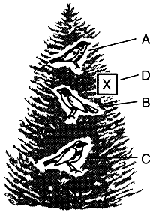
23) The diagram represents a tree containing three different species of bird, A, B, and C. Each species occupies a different niche. What is a niche?
TEAM A

Slide 25
24) The diagram represents a tree containing three different species of bird, A, B, and C. Each species occupies a different niche. A fourth species, D, which eats the same food as species B, enters the tree at point X. What type of biotic relationship will most likely exist between bird B and D?
TEAM A
Mutualism
Predator-Prey
Parasitism
Competition

Slide 26
25) The sun is the ultimate source of energy for all living things.
TEAM A
TRUE
FALSE

Slide 27
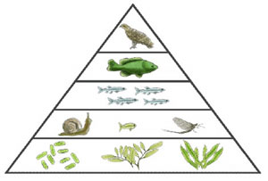
26) If the algae (producers) have 65,000 kg of biomass, how much biomass will the tertiary consumer have?
TEAM A
__________ kg

Slide 28
28)The process in which water from plant leaves evaporates into the atmosphere is
TEAM A
_______________.

Slide 29
29)Which organisms convert nitrogen into a usable form for plants & animals?
TEAM A
_______________________
Plants
Animals
Bacteria
Farmers

Slide 30
30) What is the # 1 cause of all environmental problems?
TEAM A
__________________________
Deforestation
Acid Rain
Global Warming
Overpopulation

Slide 31
31) What human impact can kill plants, dissolve and release toxic chemicals and make water more acidic, which kills plants and animals?
TEAM A
_____________________
Global warming
Ozone Layer
Acid Rain
Pollution

Slide 32
32) Which compounds from the burning of fossil fuels mix with water to form acid?
TEAM A
Compounds
___________________
& ______________
Hydrogen and oxygen
Sulfur and nitrogen compounds
Phosphorus and carbon compounds
Nitrogen and phosphorus

Slide 33
32) Deforestation is increasing the effects of global warming, because it prevents which from being removed form the air?
TEAM A
Answer choices
Oxygen
Chlorofluorocarbons
Carbon Dioxide
Ozone

Slide 34
33) Kudzu was introduced to a new habitat where they have no natural predators or parasites that limit the population growth. Kudzu is an example of?
Answer choices
TEAM A
__________________________
Population species
Invasive species
Minimum species
Carrying species

Slide 35
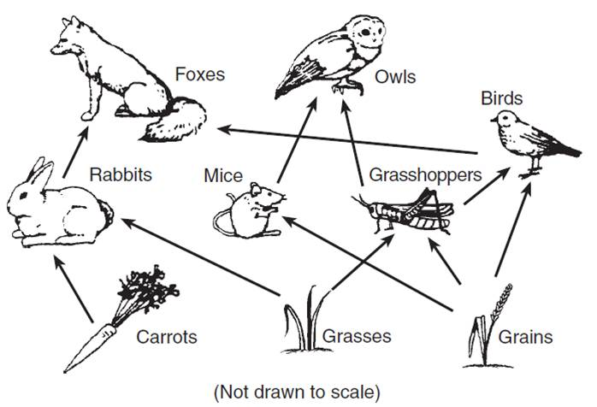
34) In the food web below, which organisms would accumulate the most toxins?
TEAM A
______________
& ______________

Slide 36
36)Which human activity is correctly paired with its likely future consequence?
TEAM A
Answer choices
Write answer below
use of fossil fuels — depletion of underground coal, oil, and natural gas supplies
genetically engineering animals — less food available to feed the world’s population
development of electric cars or hybrid vehicles — increased rate of global warming
overfishing in the Atlantic — increase in supply of flounder and salmon as food for people

