Slide 1
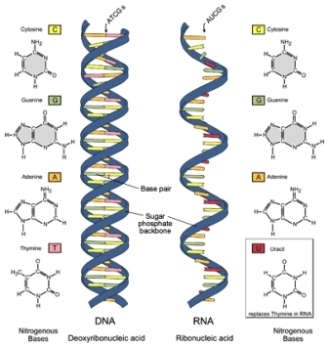
Notes: Nucleic Acids Continued
DNA vs. RNA

Slide 2
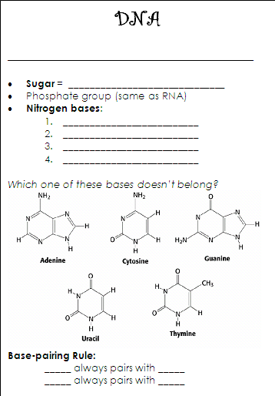
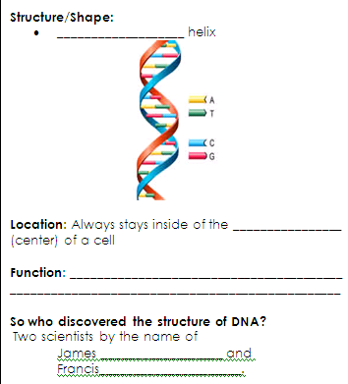

Slide 3
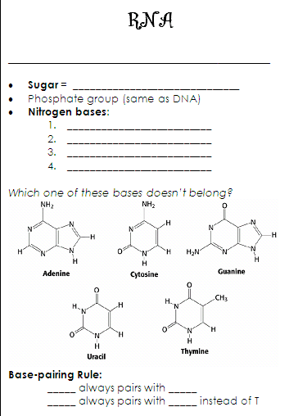
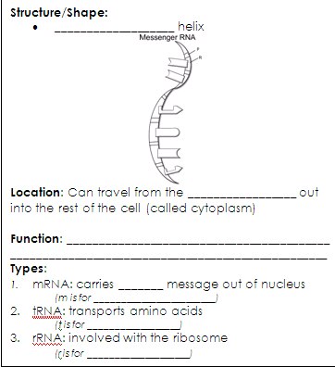

Slide 4
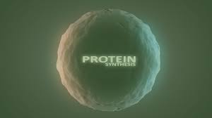
PROTEIN SYNTHESIS
TRANSCRIPTION
TRANSLATION

Slide 5
Intro. to Protein Synthesis
Watch the following 2 Amoeba Sisters Videos and complete the handouts.
“Why RNA is Just as Cool as DNA” (4:43)
“Protein Synthesis and the Lean, Mean Ribosome Machines” (7:08)

Slide 6
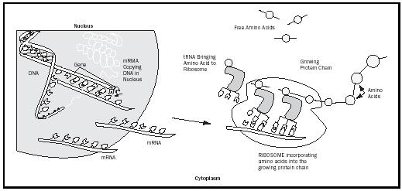
Step 1 = TRANSCRIPTION
DNA → mRNA
Step 2 = TRANSLATION
mRNA → DNA
Not on your sheet!

Slide 7
Step 1: Transcription
Process of creating mRNA from a DNA template(pattern) [DNA → mRNA]
Takes place in the nucleus
TRANSCRIPTION PROCESS:
1. Enzymes unzip the DNA molecule
Free RNA nucleotides pair with matching DNA nucleotides
C pairs with G T pairs with A
G pairs with C A pairs with U
3. When base pairing is complete, the mRNA molecule breaks away and DNA reforms.
4. The mRNA leaves the nucleus and enters the cytoplasm

Slide 8
RNA
Function:
Decodes information from DNA, then transports the message (code) to the ribosome for protein assembly.

Slide 9
Differences in DNA and RNA
DNA
Double stranded
Deoxyribose sugar
Contains Thymine as a nitrogen base
RNA
Single stranded
Ribose sugar
Contains Uracil as a Nitrogen base in place of Thymine

Slide 10
Types of RNA
mRNA – carries coded DNA message out of nucleus
tRNA – transports amino acids to the ribosome
rRNA - involved with the ribosome

Slide 11
Essential Questions
WHITE BOARD!
What is Transcription?
Where does transcription occur?
What is mRNA?
How is mRNA different from DNA?

Slide 12
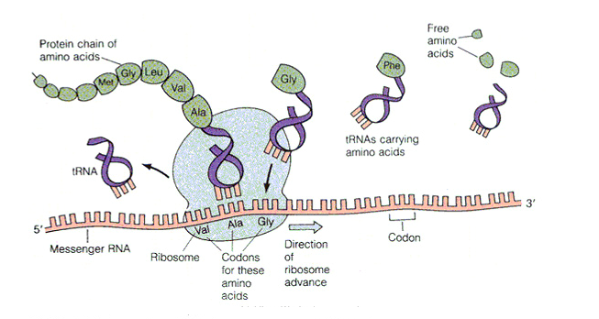
Translation
mRNA
PROTEIN
Assembling of amino acids to form proteins
The CODON sequence of mRNA is translated into the amino acid sequence of a protein
Occurs in cytoplasm at ribosomes

Slide 13
Protein Synthesis SUMMARY
The building blocks of proteins are amino acids
DNA is the blueprint for the production of PROTEINS
3 nitrogen BASES representing an amino acid is called a codon
DNA
RNA
PROTEIN
called: Central Dogma

Slide 14
Essential Questions
WHITE BOARD!
1. What is translation?
2. Where does it occur?
3. What is a codon?
4. What are the monomers of Proteins?
5. How does DNA code for protein?

Slide 15
Transcription & Translation Practice
Now complete questions 2-4 on your own

Slide 16
You have to use an mRNA codon chart!

Slide 17
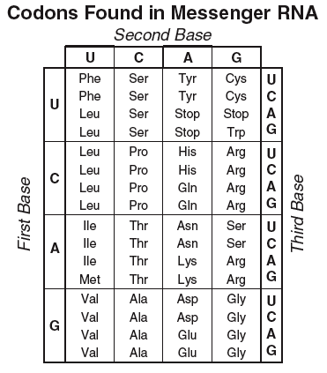
mRNA CAU UCC AAA UGA
Amino Acid Sequence: ___________________________

Slide 19
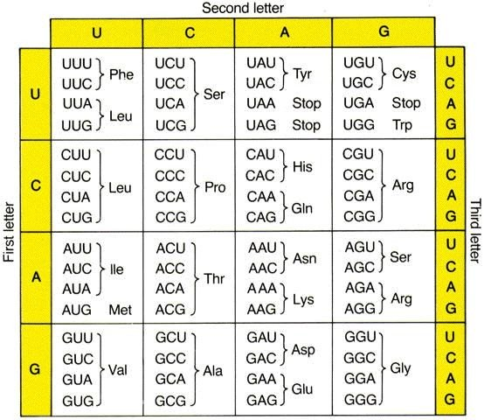
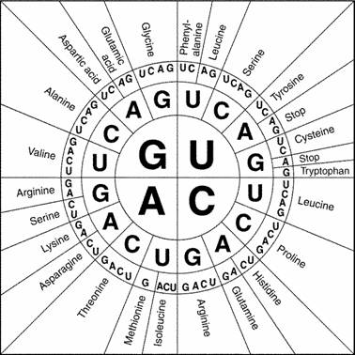
Now complete questions 10 - 16 on your own!
Check your completed work at the SSS
mRNA AUG GUU UUC AGG UAA
Amino Acid Sequence: ___________________________

Slide 20
Protein Synthesis: DNA → mRNA → Protein
NOTES!
Step 1
TransCription
DNA → mRNA
Step 2
TransLation
mRNA → Protein

Slide 21
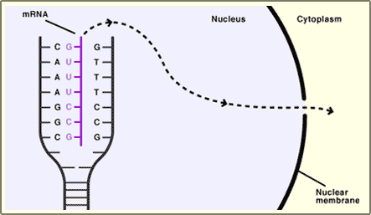
Transcription or Translation?
How can you tell?
In the nucleus
Shows DNA
see mRNA leaving

Slide 22
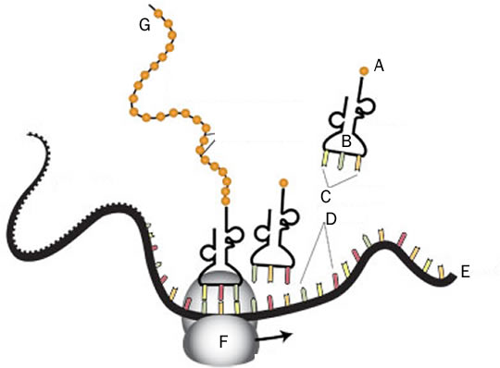
Transcription or Translation?
How can you tell?
See a ribosome
no DNA

Slide 23
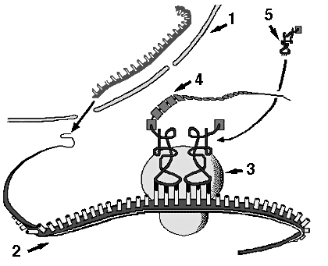
Transcription or Translation?
How can you tell?
See a ribosome
no DNA

Slide 24
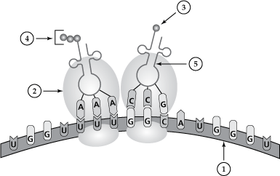
Transcription or Translation?
How can you tell?
See a ribosome
no DNA

Slide 25
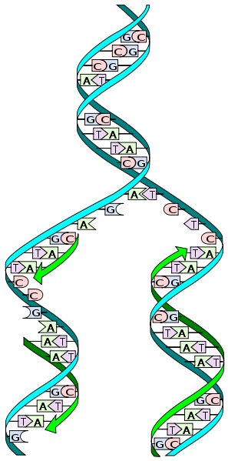
What is this process???
DNA Replication
How can you tell?
Only DNA is shown
2 identical strands of DNA
(semi-conservative replication)
no RNA (thymine only!)

Slide 26
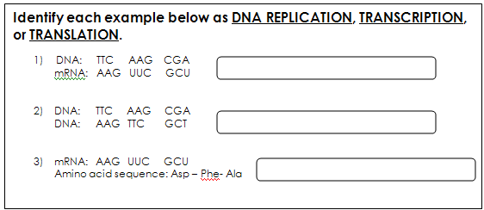

Slide 27
POGIL Time!
Groups of 4
Roles: MANAGER, READER, RECORDER, REPORTER (list names/roles on sticky notes)
We will PAUSE at #8 (model 1 key question)

Slide 28
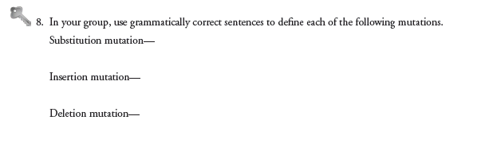
Let’s hear from a few of our REPORTERS:
CONTINUE WORKING THROUGH THE END OF THE POGIL

Slide 29
MUTATIONS
Recall, mutations are ERRORS in DNA.
They can occur during DNA Replication (Interphase) OR during cell division OR during protein synthesis.
Amoeba Sisters: “Mutations: the Potential Power of a Small Change”
  Fill in your viewing sheet while you watch. We will go over the questions afterwards.

Slide 31
DNA: GGA CAC CTC
mRNA: CCU GUG GAG
Amino Acids: Proline Valine Glutamic Acid

Slide 33
Mutations Worksheet
Original DNA Sequence:
TACACCTTGGCGACGACT
mRNA sequence ____________________
Amino Acid Sequence:
____________________
Transcription!
Translation!
Use the Codon Chart!

Slide 34
Mutations Worksheet – Try one More
Mutated DNA Sequence #1:
TACATCTTGGCGACGACT
mRNA sequence ____________________
Amino Acid Sequence:
____________________
Transcription!
Translation!
Use the Codon Chart!
Will there likely be effects? (on the protein) _____ What kind of mutation is this?

Slide 35
mRNA AUG UAG AAC CGC UGC UGA
Amino Acid Sequence: ___________________________
Will there likely be effects? What kind of mutation?

Slide 36

Protein Synthesis Activity!
An Analysis of Alien DNA

