Slide 1
PHOTOSYNTHESIS & CELLULAR RESPIRATION
Unit 3 Continued

Slide 2
POGIL – Photosynthesis, Respiration
Get in your assigned groups of 4.
Write each person’s name on the sticky note (first and last)
Select a
Reader
Reporter
Pay attention if it says write a “complete sentence.”
Pay careful attention the questions with “keys” next to them.

Slide 3
Foldable
You need:
3 handouts
Scissors
Colored pencils or markers
Highlighter (optional)
Listen for directions on how to fold and cut.

Slide 4
PHOTOSYNTHESIS * Purpose * Equation
Flap Title
Purpose:
Equation:
To convert sunlight energy into chemical energy (glucose/food)
Sunlight + Carbon Dioxide + Water → Glucose + Oxygen
(CO₂) (H₂O) (C₆H₁₂O₆) (O₂)
Inside Flap
(left side)
REACTANTS
PRODUCTS

Slide 5
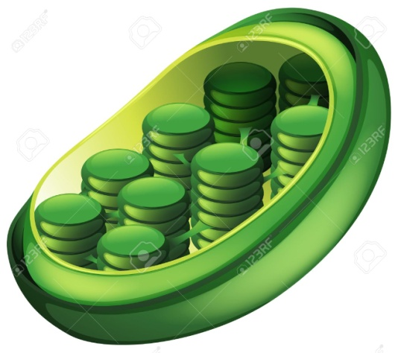
Location
Flap Title
Plants! (and some protists)
ORGANISM:
ORGAN:
ORGANELLE:
Leaves
Chloroplast (draw it!)
Inside Flap
(left side)

Slide 6
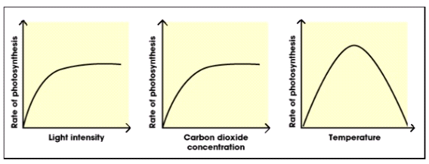
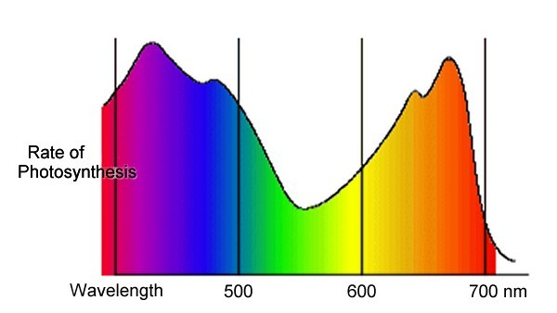
Factors that affect the RATE of Photosynthesis in plants
Flap Title
↑ Reactants = ↑ Products
1. Inc. _______ = Inc. photo.
2. Inc. _______ = Inc. photo.
3. Inc. _______ = Inc. photo.
4. Inc. _______ = Inc. photo.
5.
6. Inc. _______ = Inc. photo.
7. Inc. ____________ = Inc. photo. (b/c the plant can take in more CO₂)
sunlight
CO₂
H₂O
temperature
________________________
_________ light = ↓ photosynthesis
_________ light = ↑ photosynthesis
Light Color
Green
Red/blue
Leaf size
# of stomata

Slide 7
CELLULAR RESPIRATION * Purpose * Equation
Flap Title
Purpose:
Equation:
To convert chemical energy/food (glucose) into usable energy (ATP)
Glucose + Oxygen → Carbon dioxide + Water + ATP
(C₆H₁₂O₆) (O₂) (CO₂) (H₂O) (energy)
Inside Flap
(right side)
REACTANTS
PRODUCTS

Slide 8
Location
Flap Title
ORGANISM:
SPECIALTY CELL TYPES:
ORGANELLE:
All living things!
Muscle cells, sperm cells, nerve cells (all need lots of energy)
Mitochondria Draw it!
Inside Flap
(right side)

Slide 9
Types of Cellular Respiration
Flap Title
AEROBIC
Uses _________________
Produces _____________________
Occurs in _____________________
____________________ cells only
ANAEROBIC
No ________________
Produces _____________________
Occurs in _____________________
Oxygen
36 ATP (very efficient!)
Mitochondria
Eukaryotic
Glucose + O2 → CO2 + H2O + 36 ATP
Oxygen
2 ATP (lot less!)
Cytoplasm
Done by Prokaryotes, Yeast, and Muscle Cells

Slide 10
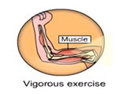
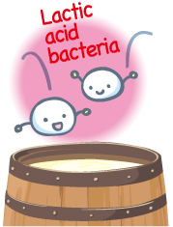
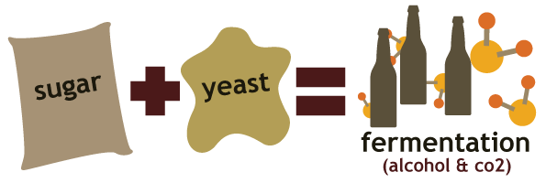
2 TYPES OF ANAEROBIC RESPIRATION
ALCOHOLIC FERMENTATION | LACTIC ACID FERMENTATION
Glucose → Ethyl Alcohol + CO₂ + 2 ATP
(very inefficient)
Glucose → Lactate (lactic acid) + CO₂ + 2 ATP
(very inefficient)
Performed by yeast and bacteria to produce wine and beer and to make bread rise!
Performed by muscle cells when oxygen runs low.
Bacteria use it because they have no mitochondria!

Slide 11
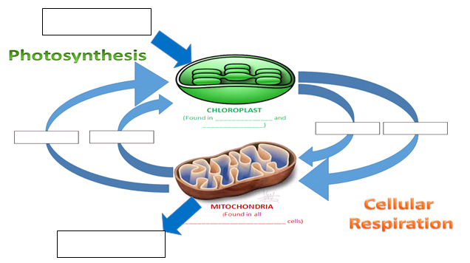
Relationship Between Photosynthesis & Cellular Respiration
Sunlight energy
Found in plants and protists.
oxygen
glucose
CO₂
water
Found in all eukaryotic cells.
ATP energy

Slide 12
Plants are autotrophs/producers → they capture sunlight energy and convert it into chemical energy (food/glucose) inside chloroplasts by the process of photosynthesis.
Plants are _____________/producers → they capture __________ energy and convert it into ___________ energy (food/glucose) inside _____________ by the process of ______________________.
Then plants (and animals) convert the ___________ (food/chemical energy) into a usable form of energy called ________ inside _________________ by the process of _______________________________.
In this cycle, the _____________ of one process/equation become the ___________ for the other.
Together, photosynthesis and cellular respiration are major components of the ____________ cycle.
Then plants (and animals) convert the glucose (food/chemical energy) into a usable form of energy called ATP inside mitochondria by the process of cellular respiration.
In this cycle, the products of one process/equation become the reactants for the other.
Together, photosynthesis and cellular respiration are major components of the carbon cycle.

Slide 13
ATP
Adenosine Triphosphate
usable
bonds
enzymes
synthesis
active

Slide 14
recycled
photosynthesis
Cellular respiration

