Slide 1
ORGANIC Chemistry = BIOchemistry =
Chemistry of LIVING Things
NOVA : “Ingredients for Life: Carbon”

Slide 2
Talk to the Text

Slide 3
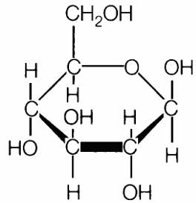
Organic vs. Inorganic Compounds
ORGANIC COMPOUNDS
INORGANIC COMPOUNDS
Contain both CARBON and HYDROGEN atoms (C-H bonds)
Found ONLY in LIVING things
Examples:
Do NOT contain BOTH carbon and hydrogen atoms (no C-H bonds)
Found in BOTH LIVING and NONLIVING things
Examples:
C₆H₁₂O₆ (glucose)
CH₄ (methane)
H₂O (water)
CO₂ (carbon dioxide)
SO₂ (sulfur dioxide)
NaCl (sodium chloride/table salt)

Slide 4
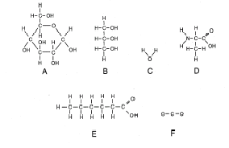
Which compounds are ORGANIC? How do you know?

Slide 5
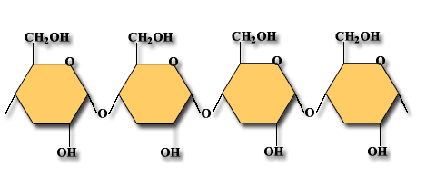
Monomers (simple)
Polymers (complex)
Few bonds
Store less energy (because fewer bonds)
Smaller
These are the building blocks for our major organic molecules of life
Many bonds
Store more energy (because many bonds)
Larger
There are 4 main organic molecules of life.

Slide 6
4 Organic Compounds:
POLYMER / MACROMOLECULE | MONOMER (building block subunit)
1. Carbohydrates | Monosaccharides (simple sugars)
2. Lipids | Glycerol & Fatty Acids
3. Proteins | Amino Acids
4. Nucleic Acids | Nucleotides
Video: “The Biomolecule Band”

Slide 7
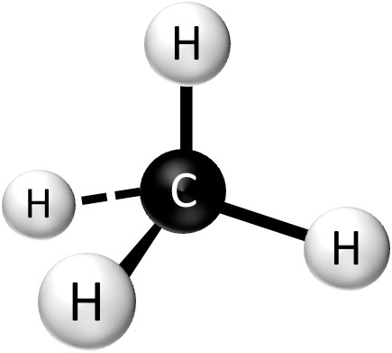
Review!
1) Is this molecule ORGANIC or INORGANIC?
WHY?

Slide 8
Review!
2) What do the lines in this picture represent?
What is stored in these lines/bonds?

Slide 9
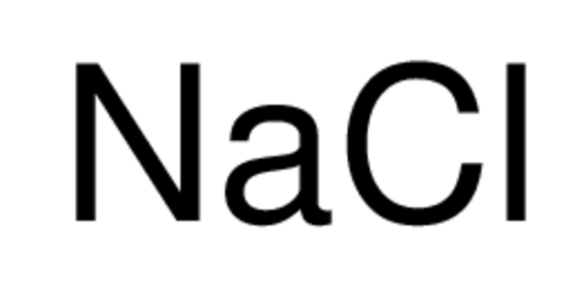
Review!
3) Is this compound ORGANIC or INORGANIC?
WHY?

Slide 10
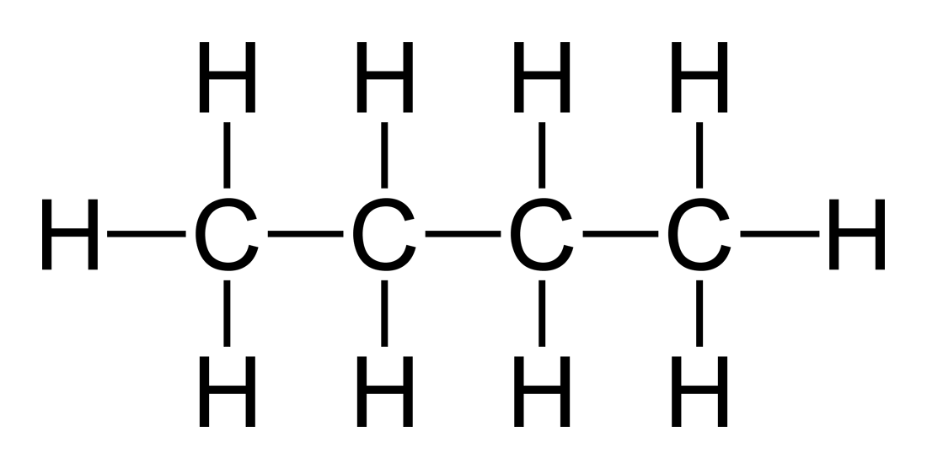
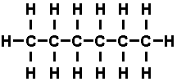
Review!
4) Which compound/molecule has the MOST stored energy?
A
B
WHY?

Slide 11
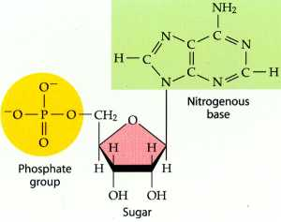
Review!
5) Is this molecule ORGANIC or INORGANIC?
WHY?

Slide 12
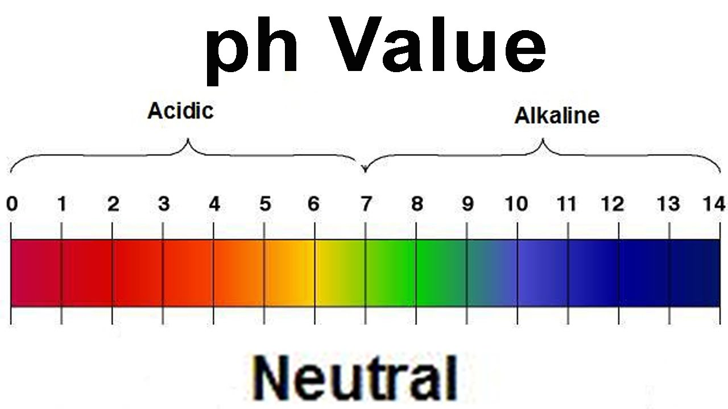
pH Scale
Acids = _______________ Neutral = _____________ Bases = _______________

Slide 13
Buffers
Scan the QR code and watch the video.
Answer the questions.
No QR scanner?
Google or go to YouTube and search for “Chemistry 12.7 Buffers”

Slide 14
Organic Molecules (Biomolecules)
The presentation is on the website: lindsaymathisbiology.weebly.com
For each organic compound, you will read and “Talk to the Text” with a partner first. Then we will record the important information together.
Throughout the lecture, some slides are in yellow. These slides DO NOT go in your notes.

Slide 15
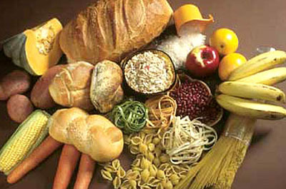
CARBOHYDRATES
Organic Molecule #1
Let’s Read and Talk to the Text!
Chunk/divide the text into 4 sections
Read one section at a time.
Alternate by using the sentence starters to “talk” to the text.

Slide 16
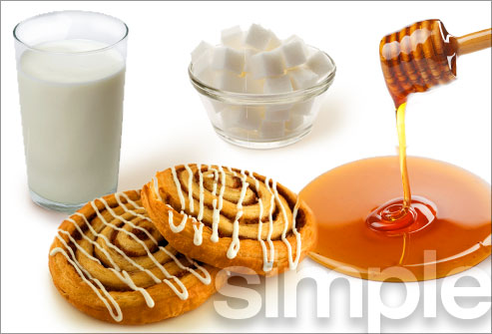

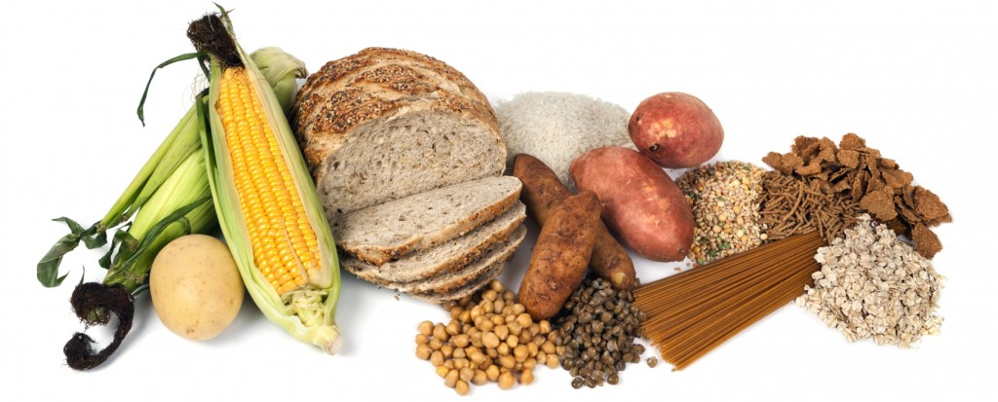
Carbohydrates: What are they?
Sugars!!!
Some are sweet (simple carbs)
Some are not sweet (complex carbs…a.k.a starches)

Slide 17
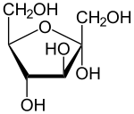
Carbohydrates: What ELEMENTS (atoms) make up its structure?
Carbon [C],
Hydrogen [H]
Oxygen [O]
Organic – because it has C-H bonds)
CHO are found in a 1:2:1 ratio
1C : 2H : 2O

Slide 18
Carbohydrates: What are the MONOMERS (building blocks, subunits)?
Monosaccharides
  (Simple Sugars)
This is Glucose!
Glue this picture under “monomers”

Slide 19
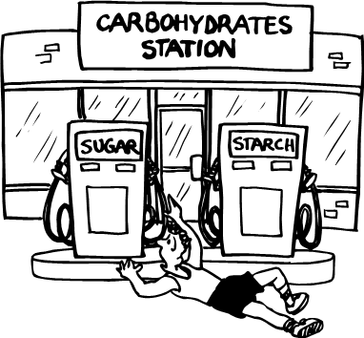
Carbohydrates: What are the FUNCTIONS?
Quick Energy

Slide 20
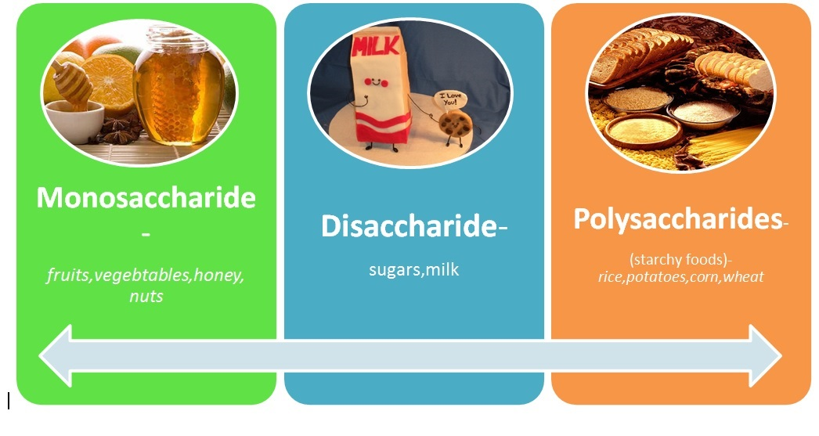
Carbohydrates: provide ENERGY!
Simple Carbohydrates
  Quickest Energy
  Monosaccharides
  Disaccharides
2. Complex Carbohydrates
  Polysaccharides
  Slower release

Slide 21
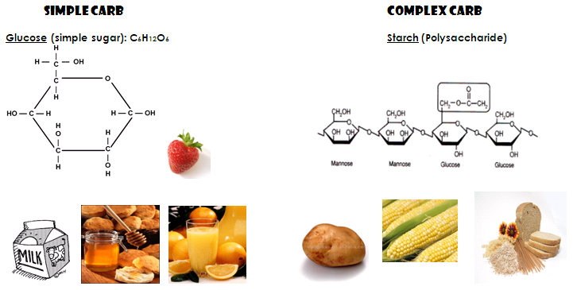
Simple Sugars → quickest energy
Complex sugars → more energy (more bonds!)
Which type of carbohydrate will provide the most energy? Why?

Slide 22
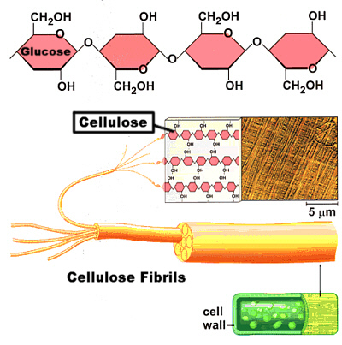
Carbohydrates: What are the FUNCTIONS?
2. Form cell walls of plants

Slide 23
Carbs: What are EXAMPLES/TYPES?
Glucose – C₆H₁₂O₆ - made by plants during photosynthesis
Cellulose – complex sugar in plant cell walls
Starch – complex stored sugar in plants
Glycogen – complex stored sugar in animals
Some carbs you may have heard of…
Sucrose – table sugar
Lactose - milk sugar
Fructose – fruit sugar
Carbs often end in –ose!

Slide 24
Carbs: WHERE are they located in living things?
Humans: Glycogen is stored in liver cells
Plants:
  Cellulose – (=fiber!!!) makes up cell walls of plant cells
  Glucose – made in leaves
  Starch – stored in fruits, vegies (potatoes!)

Slide 25
Carbohydrates: What FOODS are they in?
Glue the picture under “foods” and list some!
Plant foods!

Slide 26
Nutrient Tests / Indicators
How can we be SURE that these organic macromolecules (big polymers) are actually in the foods we eat?
We can use INDICATORS – substances that change color in the presence of a compound.

Slide 27
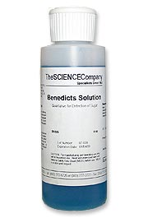
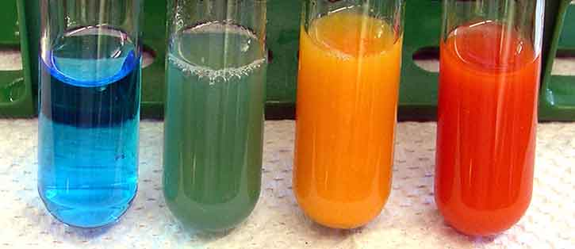
How do you TEST for CARBOHYDRATES in foods?
2 Tests!
Name, describe, and draw each test in your notes!
Benedict’s – test for simple sugars

Slide 28
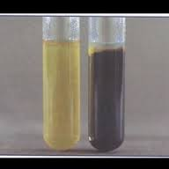
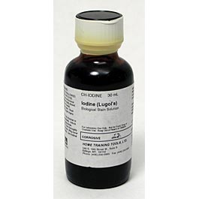
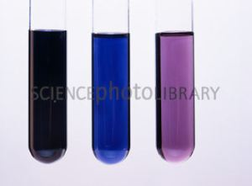
How do you TEST for CARBOHYDRATES in foods?
Iodine – test for starch

Slide 29
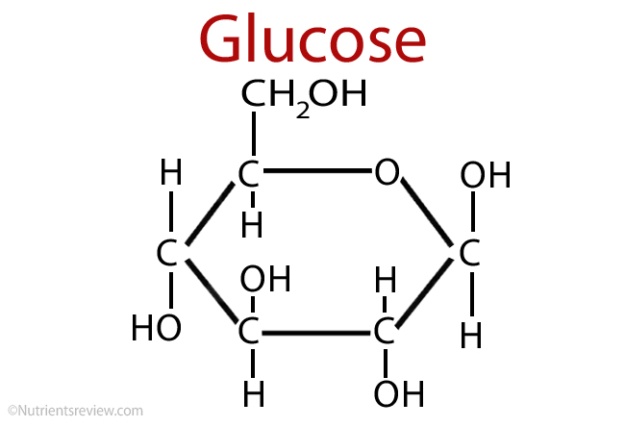
BIG IDEA:
Carbohydrates are the main source of QUICK ENERGY

Slide 30
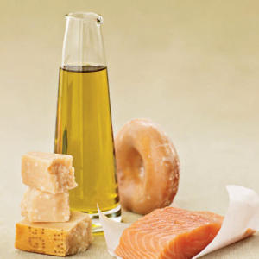
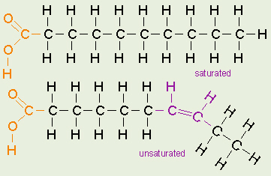
LIPIDS
Organic Molecule #2
Let’s Read and Talk to the Text!
Chunk/divide the text into 4 sections
Read one section at a time.
Alternate by using the sentence starters to “talk” to the text.

Slide 31
LIPIDS: A Comparative Study
As we learn about Lipids, keep in mind how they are both SIMILAR and DIFFERENT from Carbohydrates.

Slide 32
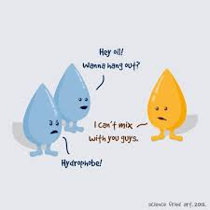
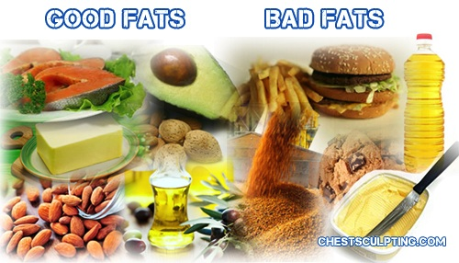
Lipids: What are they?
Fats!!!
Hydrophobic (“water fearing”) molecules that do not dissolve in water and have diverse functions

Slide 33
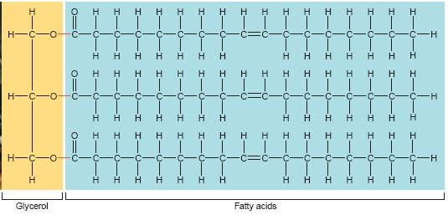
Lipids: What ELEMENTS (atoms) make up its structure?
Carbon[C],
Hydrogen [H]
Oxygen [O]
Organic – because it has C-H bonds)

Slide 34
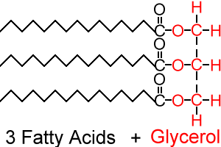
Lipids: What are the MONOMERS (building blocks, subunits)?
Fatty Acids
Glycerol
3 Fatty Acids + Glycerol = Lipid
Lipids are shaped like the letter “E”!
Find the picture that looks like a lipid and glue it under “monomers”

Slide 35
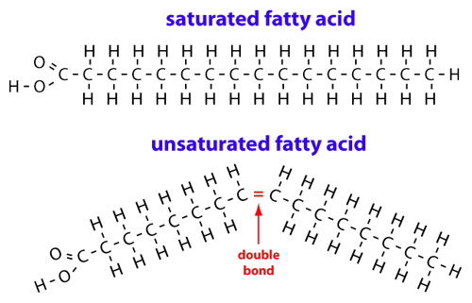
Lipids: 2 varieties
Unsaturated Fats
  Come from plants: oils (liquid)
Saturated Fats
  - Come from animals: fats (solid)

Slide 36
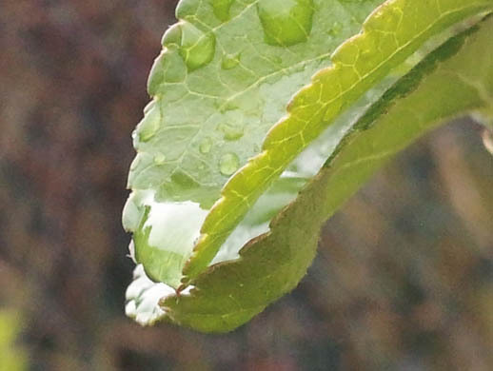
Lipids: What are the FUNCTIONS?
***Energy storage (long term energy)
Give warmth and insulation to animals (blubber)
Forming the membrane around cells
Provide waterproof coverings for plant leaves.
Hormones and vitamins

Slide 37
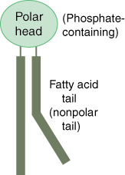
Lipids: What are EXAMPLES/TYPES?
Fats (come from animals)
Oils (come from plants)
Waxes: form water-proof coverings of plant leaves
Phospholipids (part of all cell membranes)
Steroids (like cholesterol)

Slide 38
Lipids: WHERE are they located in living things?
Humans: Fat is stored in adipose cells; the body can store more lipids than carbohydrates
Plasma membranes (both plants and animals)
Waxes can form water-proof coverings of plant leaves

Slide 39
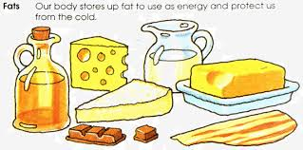
Lipids: What FOODS are they in?
Fats: lard, butter, mayonnaise (saturated, from animals)
Oils: vegetable oil, peanut oil (unsaturated, from plants)
Glue the picture under “foods” and list some!

Slide 40
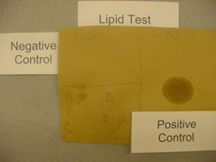
Lipids: How do you TEST for them in foods?
Brown paper bag test: lipids will leave a shiny translucent spot after any liquids have evaporated.
Draw it!

Slide 41
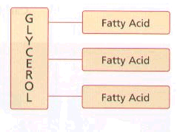
BIG IDEA:
Lipids are the main source of STORED (long term) ENERGY

Slide 42
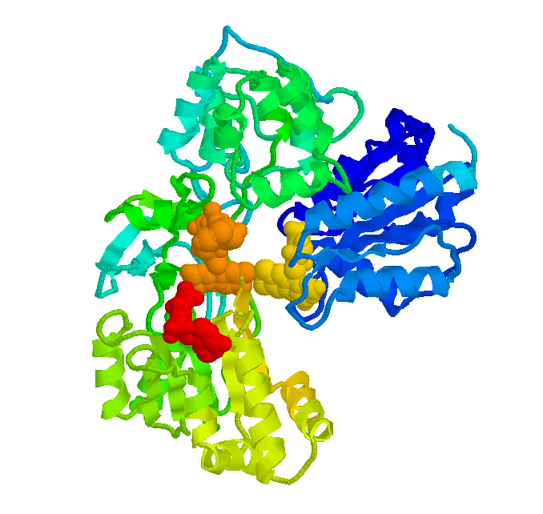
Proteins
Organic Compound #3
Let’s Read and Talk to the Text!
Chunk/divide the text into 4 sections
Read one section at a time.
Alternate by using the sentence starters to “talk” to the text.

Slide 43
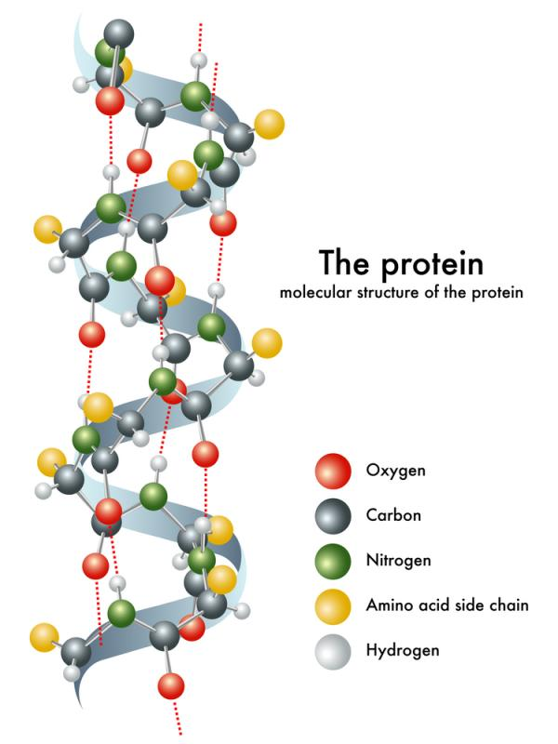
Protein: What ELEMENTS (atoms) make up its structure?
Carbon[C],
Hydrogen [H]
Oxygen [O]
Nitrogen [N]
Organic – because it has C-H bonds)

Slide 44
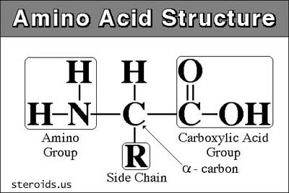
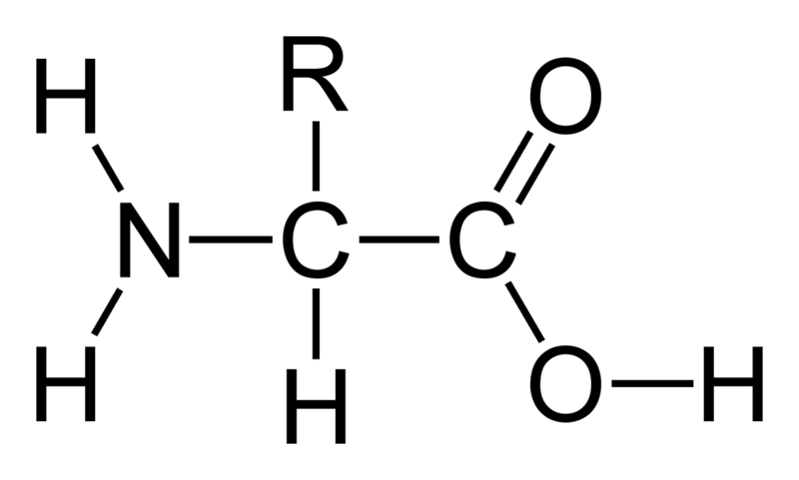
Proteins: What are the MONOMERS (building blocks, subunits)?
Amino Acids
There are 20 different amino acids!
Find the picture that looks like an amino acid and glue it under “monomers”

Slide 45
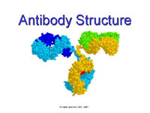
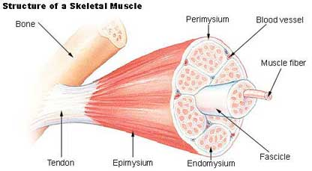
Proteins: What are the FUNCTIONS?
Structural support in cell membranes and muscle tissue
Transport
Regulate chemical reactions (enzymes)
Act as chemical messengers (hormones)
Protection/Immunity (antibodies defend against infections)

Slide 46
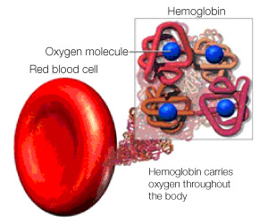
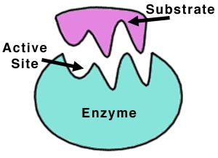
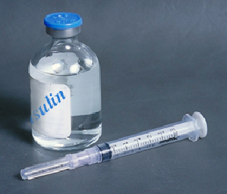
Proteins: What are some EXAMPLES/TYPES?
ENZYMES – speed up chemical reactions
HEMOGLOBIN – carries oxygen on red blood cells
INSULIN – regulates blood glucose
ANTIBODIES – fight infections

Slide 47
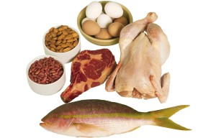
Proteins: What FOODS are they in?
Glue the picture under “foods” and list some!

Slide 48
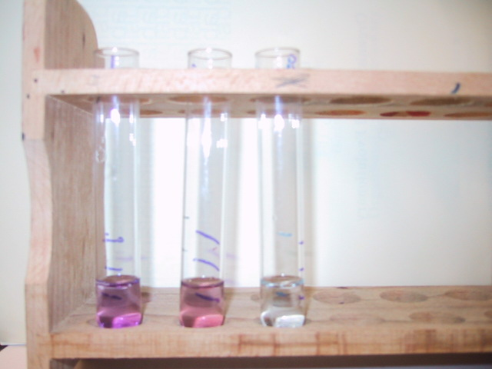
Proteins: How do you TEST for them in foods?
Biurets Solution – turns from blue to pink/purple

Slide 49
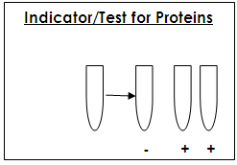
Biurets
Blue → Purple/Pink
Draw it!

Slide 50
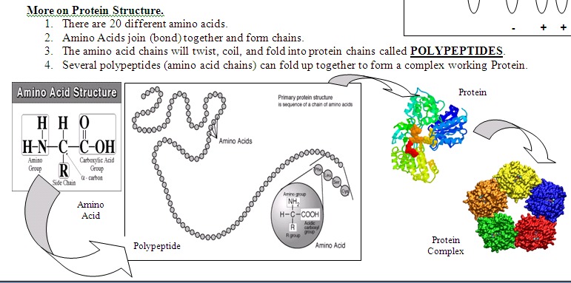

Slide 51
Organic Molecule #4
Nucleic Acids

Slide 52
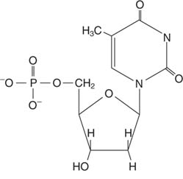
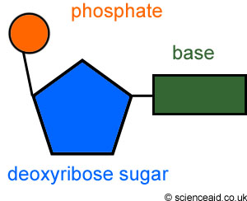
Structure:
ELEMENTS/ATOMS:
C, H, O, N, P (phosphorus)
MONOMER: (Building Block): Nucleotide
  3 parts of a nucleotide:
    Sugar
    Phosphate group
    Nitrogen base
Glue the picture of the nucleotide under “monomer.” Highlight the 3 parts of a nucleotide!

Slide 53


Functions
To store and transmit (pass on) hereditary (genetic) information
To provide instructions for making proteins

Slide 54


EXAMPLES/TYPES
Deoxyribonucleic Acid
Ribonucleic Acid
Add simple pictures of each type in your foldable.

Slide 55
INDICATOR TESTS:
None for Nucleic Acids
Nucleic Acids are found in all of our foods, but provide no nutritional value

Slide 56
FOODS:
Technically, DNA is found in all foods!
But again, nucleic acids provide no nutritional value

