Slide 1
Unit 7: Genetics
The study of genes, traits, and heredity!

Slide 2
Inventory of Traits Survey
Complete the Survey according to the traits you have.
Then we will get some class data!
Are these traits heritable (genetic) or environmental (acquired)? Can a trait be both?

Slide 3
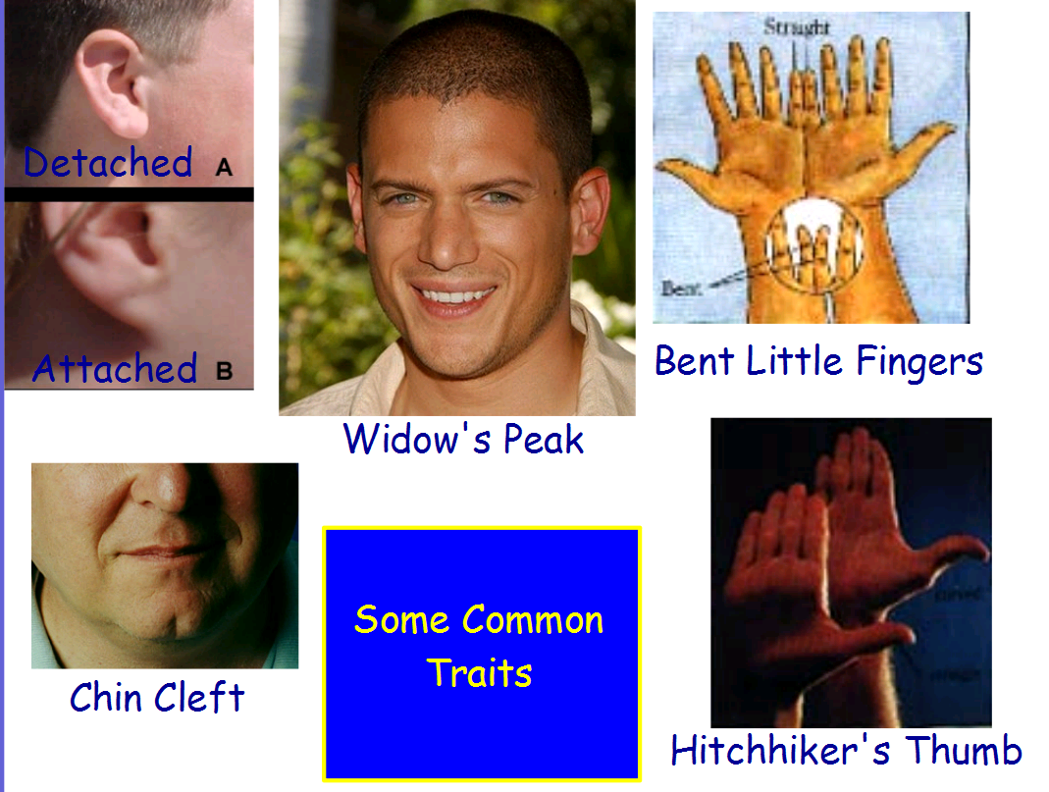

Slide 4
What are TRAITS?
Traits are characteristics.
Traits can be inherited (through genes) or acquired (from environment or experience)

Slide 5
What are GENETIC TRAITS?
Genetic Traits are determined by your genes.
  Also affected by the environment
Remember, GENES code for PROTEINS
PROTEINS determine TRAITS

Slide 6
TABLE TALK!!!
Thinking about our traits: Work with a partner to discuss and answer the following questions.
  Some human traits can by changed by human intervention and some cannot. List some examples of traits that can be altered/changed by human intervention. Think of some that may not be in our inventory!
  You probably already know that some traits are genetic and others are environmental. But most human traits reflect an interaction between genetic and environmental factors. Name some traits that might be the result of BOTH genetics (nature) and environment (nurture). Then discuss/explain why you think so.
  Variations are differences. Describe some of the benefits of human genetic variation. What are some of the potential problems that it can cause?

Slide 7
Linking Genetics with Reproduction
In the word bank, HIGHLIGHT the words HEREDITY, GENETICS, and TRAIT.
Read the page and use the vocabulary word bank to fill in the blanks.
Use context clues!
Re-read portions to better understand.
A few words are not included, like:
  Sex, Sperm, Egg, Haploid, Meiosis

Slide 8
Meet Gregor Mendel!
PART 1:
Get a textbook from the cabinet.
Read pp. 263-266 and answer the questions on your paper
Return the textbook to the cabinet.
PART 2:
Pick up a colored handout (do not keep) from the front lab bench.
Read about Mendel’s Experiments and Laws.
Fill in your sheet.
Return the colored sheets to the front lab bench.

Slide 9
Gregor Mendel
Video: How Mendel’s pea plants helped us understand genetics (www.youtube.com/watch?v=Mehz7tCxjSE)

Slide 10

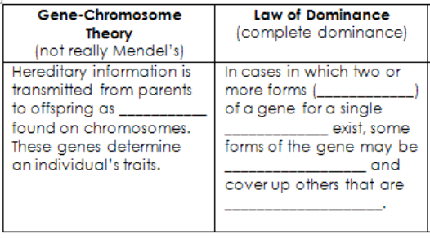
The “father” of genetics.
ALLELES
GENES
TRAIT
DOMINANT
RECESSIVE

Slide 11
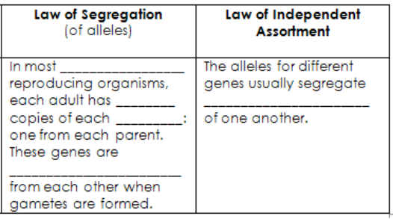
sexually
2
independently
gene
Segregated/separated

Slide 12
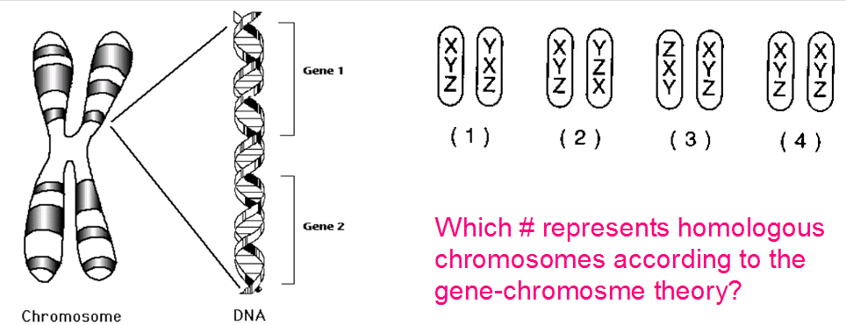

Slide 13
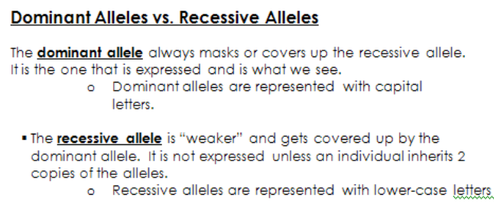
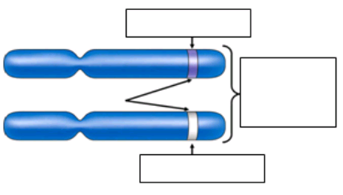
GENE/ALLELE
Homologous Chromosomes
GENE/ALLELE

Slide 14
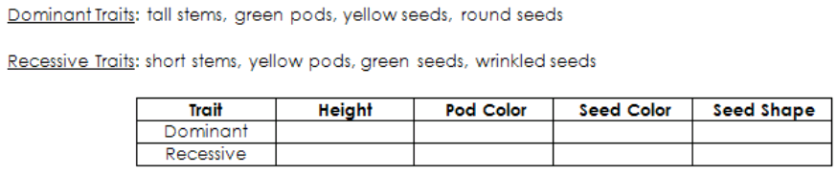

Slide 15
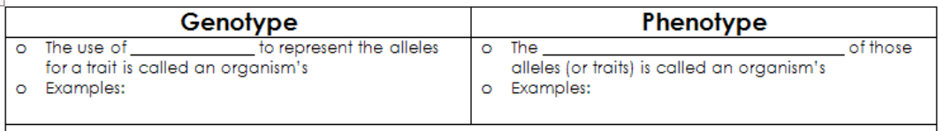
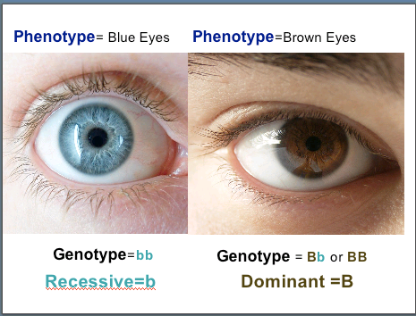
letters
Physical appearance

Slide 16
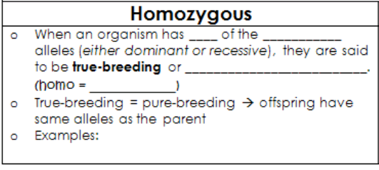
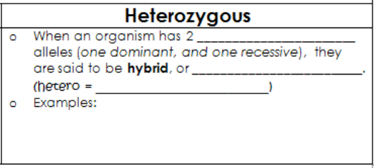
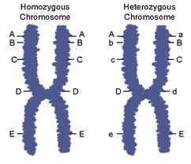
2
SAME
HOMOZYGOUS
SAME
DIFFERENT
HETEROZYGOUS
DIFFERENT

Slide 17
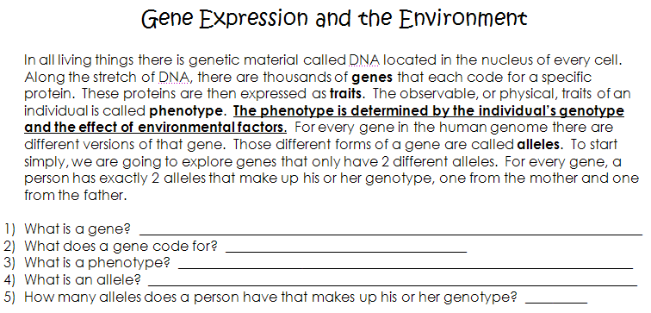

Slide 18
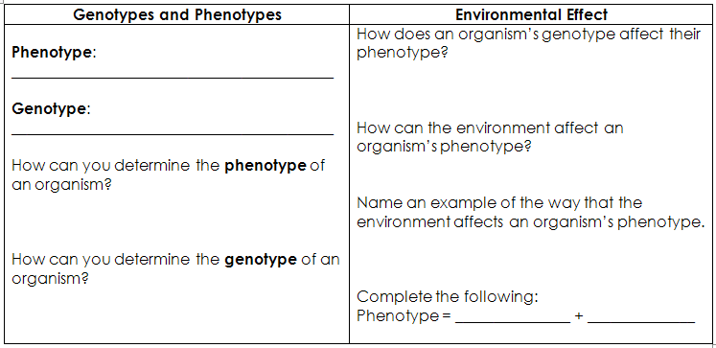
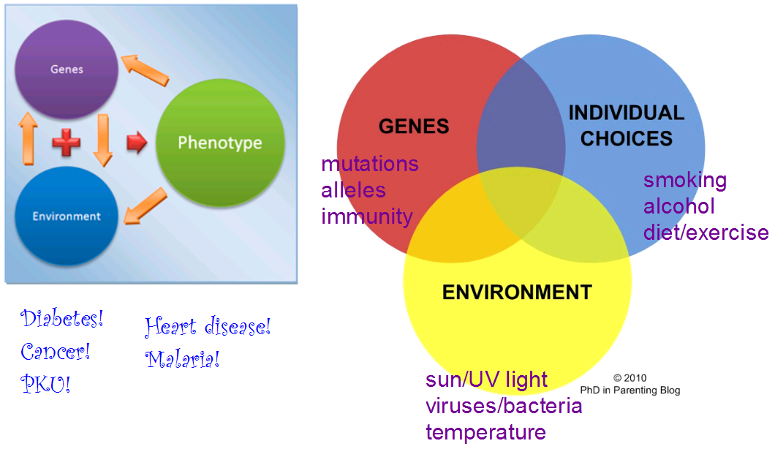
Observable, physical trait
Genotype determines phenotype
Gene/allele combination; the LETTERS
Environment interacts with genes to alter and affect traits/phenotypes
Look at it!
Examine the genes
Genotype
Environment

Slide 19
Genotypes and Phenotypes | Environmental Effect
Phenotype: ___________________________________ Genotype: ___________________________________ How can you determine the phenotype of an organism? How can you determine the genotype of an organism? | How does an organism’s genotype affect their phenotype? How can the environment affect an organism’s phenotype? Name an example of the way that the environment affects an organism’s phenotype. Complete the following: Phenotype = _______________ + ______________

Slide 20
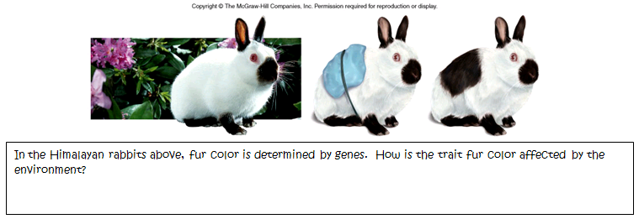

Slide 21
Genetics Vocabulary Practice
Complete front side only.
Check answers at the SSS!

Slide 22
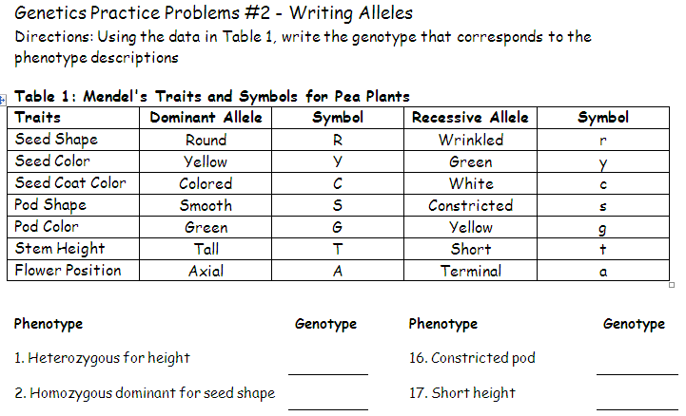
Genetics Practice Problems #2: Writing Alleles
Complete the rest and check your answers at the SSS before moving on to the “Reading” about Gene Chromosome Theory

Slide 23
Amoeba Sisters: Mendelian Inheritance
Complete the questions as we watch.
We may pause throughout!

Slide 24
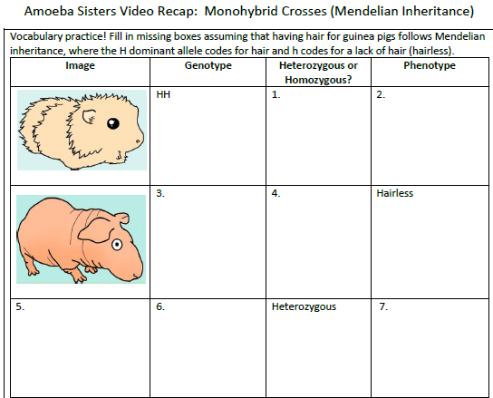

Slide 25
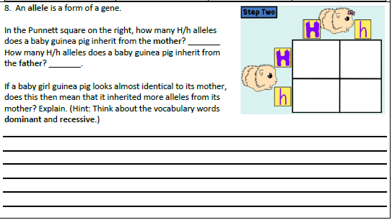

Slide 26
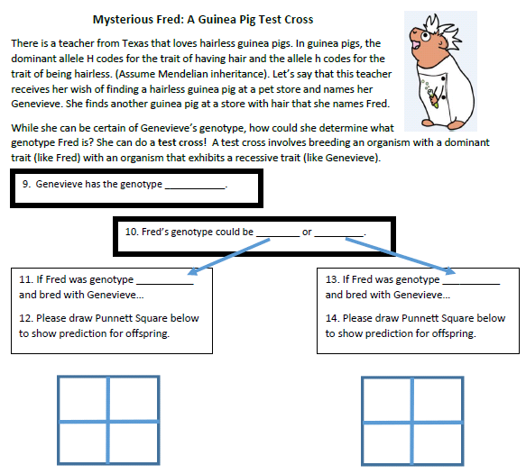

Slide 27
“Hornimonsters”
A Heredity Simulation
Work in pairs.
Fill in your data table then answer the questions!

Slide 28
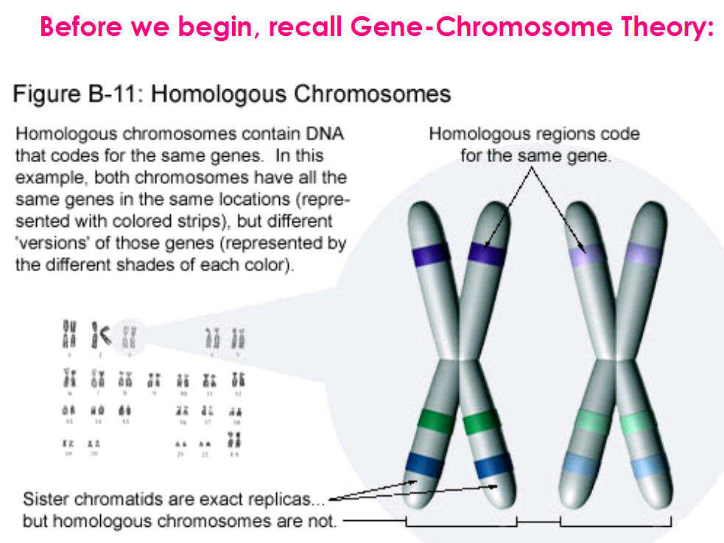

Slide 29
The Punnett Square
TAKE NOTES!
A tool used to predict POSSIBLE genetic outcomes (likelihood) for a trait
Terminology:
  P = parental generation
  F₁ = first filial (first generation offspring of parents)
  F₂ = second filial (offspring of the first generation)

Slide 30
The Punnett Square
Example:
  In peas, Round (R) is dominant to wrinkled (r).
  Cross a homozygous round parent with a homozygous wrinkled parent.
Gametes/alleles from Parent 1
Gametes/alleles from Parent 2
F₁ Results:
Genotype Ratio:
___RR: ___Rr: ___rr
Phenotype Ratio:
___Round : ___Wrinkled

Slide 31
One More Punnett Square
Example:
  Cross two of the F1 offspring from the first cross. That means cross two heterozygous round peas.
Gametes/alleles from Parent 1
Gametes/alleles from Parent 2
F₂ Results:
Genotype Ratio:
___RR: ___Rr: ___rr
Phenotype Ratio:
___Round : ___Wrinkled

Slide 32
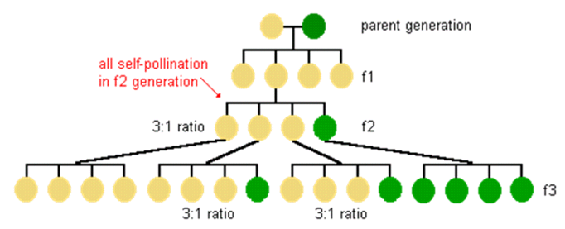
Seeing What Gregor Mendel Saw!
Hybrid/heterozygous crosses always result in a 1:2:1 Genotype Ratio!
Hybrid/heterozygous crosses always result in a 3:1 Phenotype Ratio!

Slide 33
Real Life Science
Picky Eater
What is YOUR PHENOTYPE for PTC tasting?
How could you determine your actual genotype?

Slide 34
Practice – together!
4. The ability to taste the chemical PTC is determined by a single gene in humans with the ability to taste given by the dominant allele T and the inability to taste by the recessive allele t. Suppose two heterozygous tasters (Tt) have a large family. What is the likelihood that their first child will be a taster?
STEP 1 | KNOW YOUR PHENOYPES
STEP 2 | CHOOSE YOUR LETTERS
STEP 3 | WHO ARE THE PARENTS?
Parent 1
Parent 2
STEP 4 | SET UP YOUR SQUARE
Taster
Non-taster
RESULT:
____% chance child will be a taster
Taster (T)
Non-taster (t)
Tt
Tt

Slide 35
Practice – together!
5. In pea plants, spherical seeds (S) are dominant to dented seeds (s). In a genetic cross, one of the two plants is heterozygous for the seed shape trait, while the other is homozygous dominant. What fraction of the offspring should have spherical seeds?
STEP 1 | KNOW YOUR PHENOYPES
STEP 2 | CHOOSE YOUR LETTERS
STEP 3 | WHO ARE THE PARENTS?
Parent 1
Parent 2
STEP 4 | SET UP YOUR SQUARE
Spherical
Dented
RESULT:
____ chance of a spherical seed pea
Spherical (S)
Dented (s)
Ss
SS

Slide 36
Independent Practice
Work on 6-9.
Check your answers at the SSS.
Raise your hand if you need help.

Slide 37
Huntington’s – A Dominant Trait
Level 1: Huntington’s is a disease caused by a dominant allele. Being “normal” is recessive.
Task: Make a key to show the possible genotype/phenotype combinations.

Slide 38
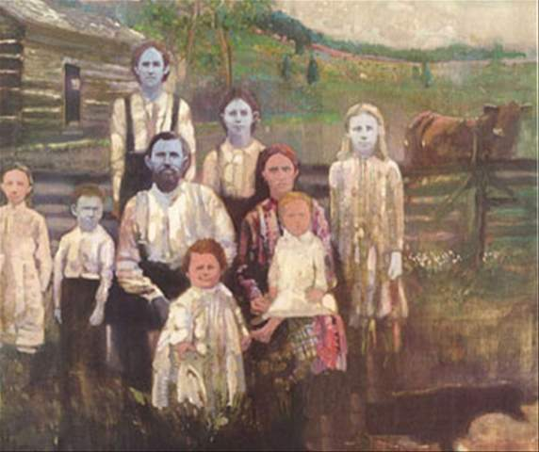
True Blue (A Close Read)
Use the margins to do a “close read” of the article.
Remember:
  Highlight unfamiliar/key terms
  Ask questions
  Make connections and comments
Answer the questions at the end

Slide 39
“Ghost in Your Gene”
Use the remainder of class time to complete your video viewing and answer the questions.
Turn in your completed work; otherwise, finish for homework.

Slide 40
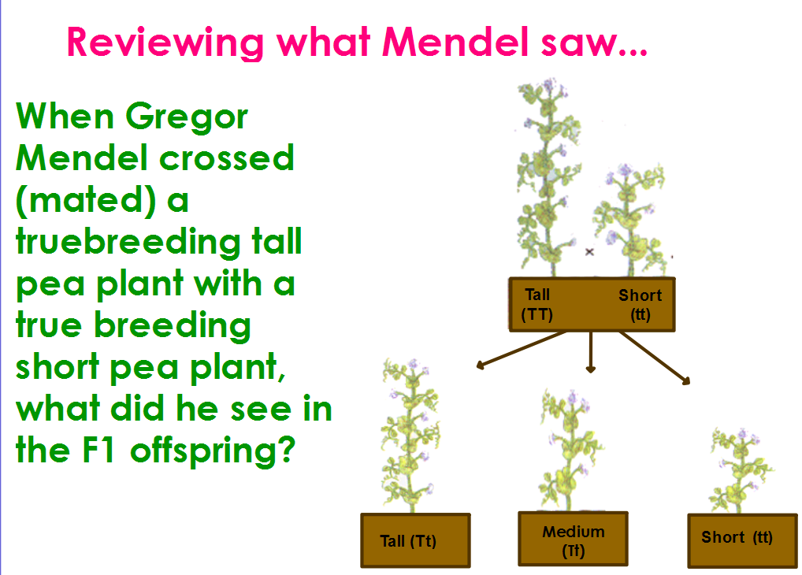

Slide 41
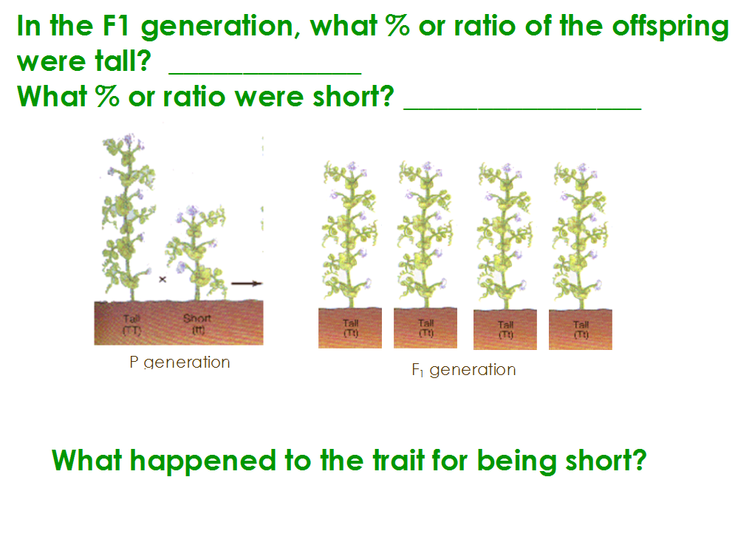

Slide 42
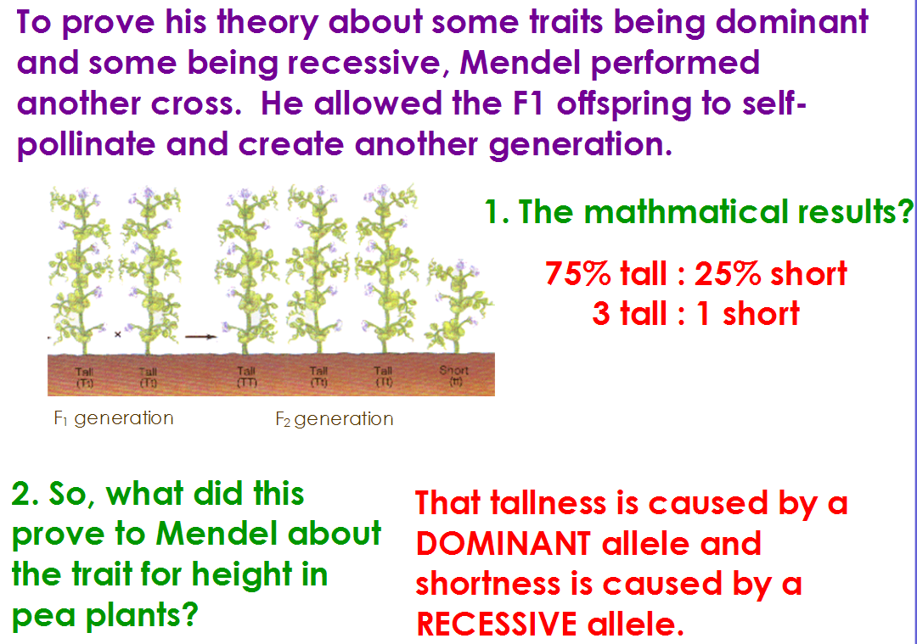

Slide 43
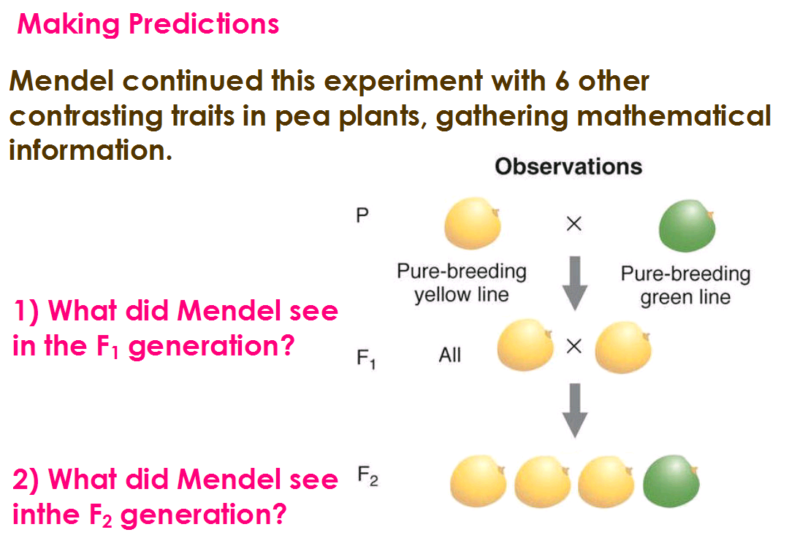

Slide 44
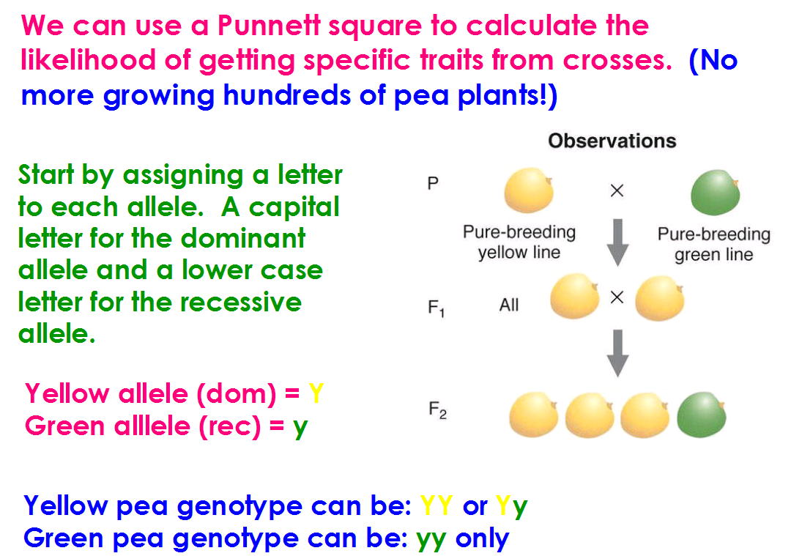

Slide 45
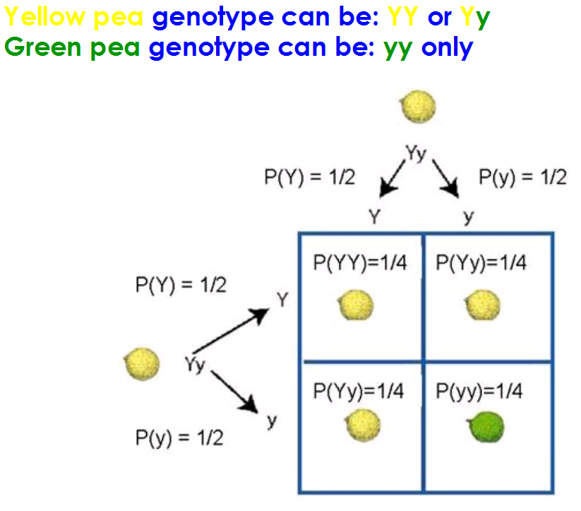

Slide 46
Practice Time
Work through the problems.
Read the information.
Make a key.
Do the cross.
Answer the question!
Answers are at the SSS.
NO PENS/PENCILS.

Slide 47
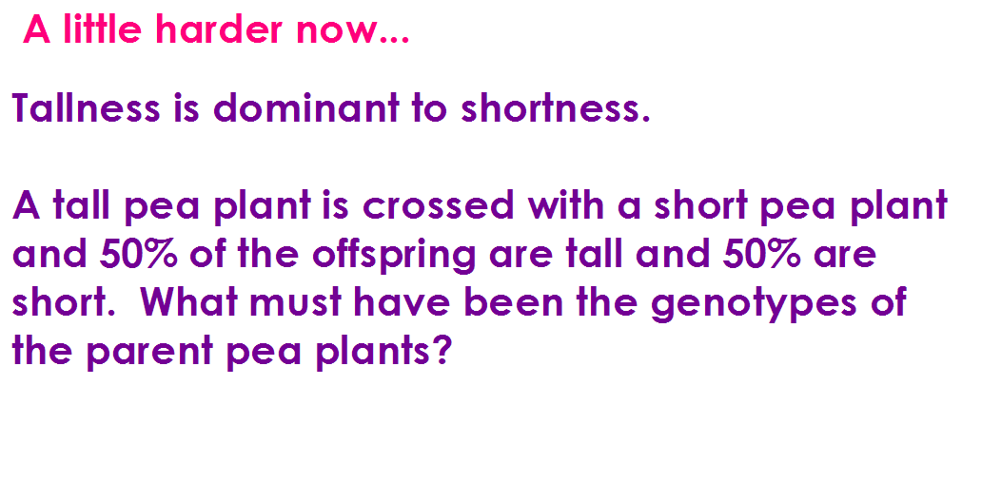
#1

Slide 48
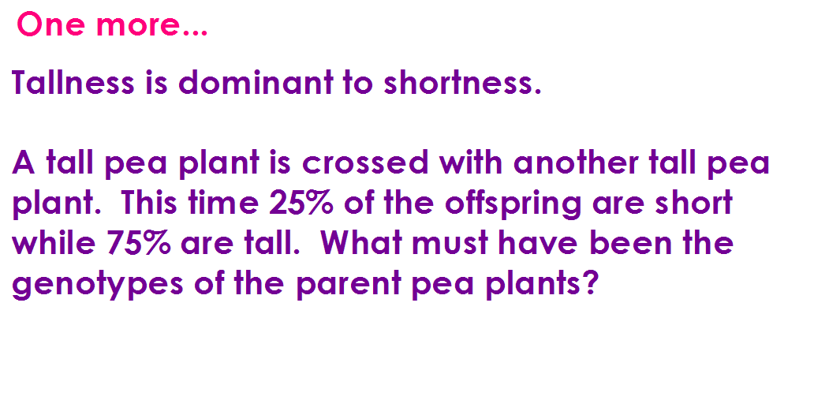
#2

Slide 49
Human Genetic Diseases
Diseases caused by DOMINANT ALLELES:
  Huntington’s Disease – disease that deteriorates the brain.
Diseases caused by RECESSIVE ALLELES:
  Cystic Fibrosis

Slide 50
Cystic Fibrosis
An inherited disease that causes thick sticky mucus to build up in the lungs and digestive track.
Caused by a recessive allele

Slide 51
Example #1:
Cystic fibrosis is a recessive disease. Being normal is dominant. If Sarah and Ben are both heterozygous normal, what is the likelihood they will have a child with the CF disease?

Slide 52
#2) Your Turn
Cystic fibrosis is a recessive disease. Being normal is dominant. Manuel and Luisa just learned their baby boy has CF disease. Although Manuel is normal, Luisa has cystic fibrosis. What must be Manuel’s genotype?

Slide 53
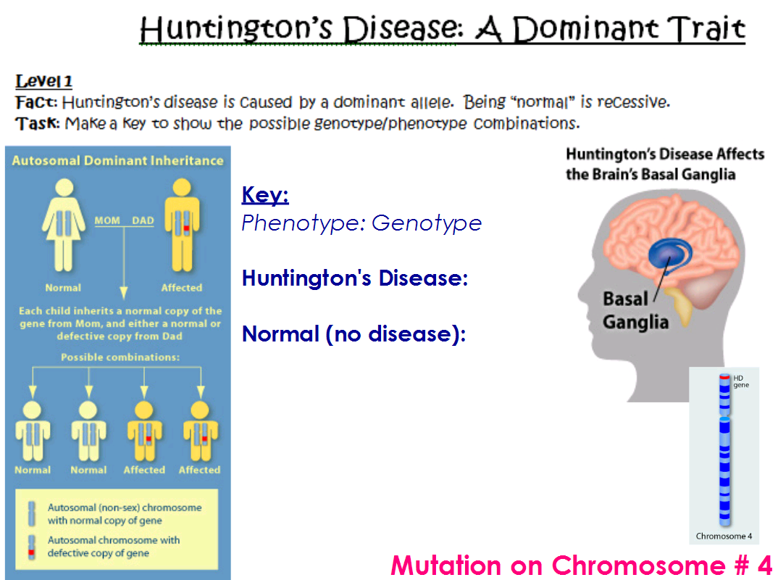

Slide 54
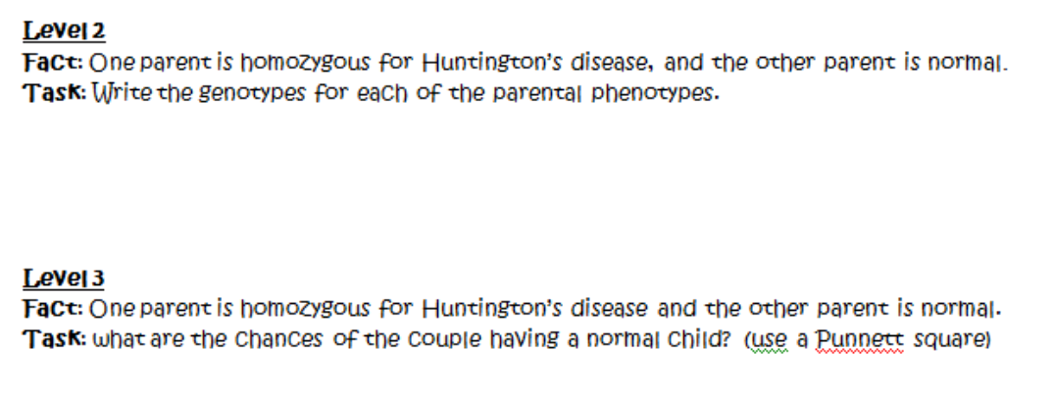

Slide 55
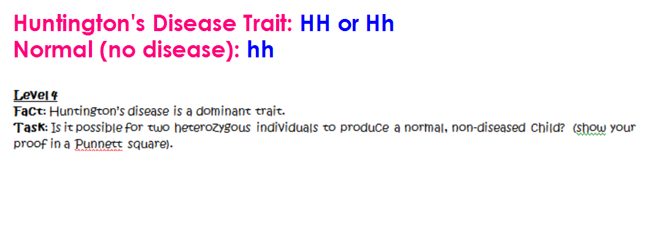

Slide 56
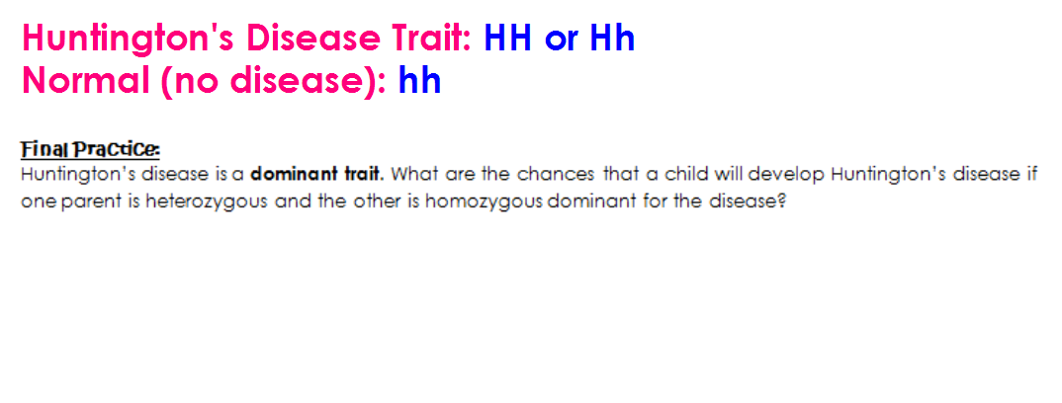

Slide 57
Norwegian Hideout
You will work with a partner. BOTH partners should complete the work.
Pick any station to start at!
Write and solve your answers on the answer sheet.
  Show your work (Punnett Squares) for #3, 4, 6, 7, 9, and 11.
Good luck!

Slide 58
Partners – 2nd block
Choose a partner from the OPPOSITE Group that you are in.
Group A
Group B
Tykese
Jessica
Ram
Neilyn
Adona
Lataisha
Trinity
Jerquavius
Juan
Leo
Karisma
Kamal
Deondre
DaVante
Omer
Hector
David
Marlon

Slide 59
Partners – 3rd block
Choose a partner from the OPPOSITE Group that you are in.
Group A
Group B
Maurice
Alexa
Ka’Dasia
Winston
Adrian
Sincere
Jesus
Jovan
Rita
Taiya
Doctor
Makayla
Andres
Akira
Trayvone
Akwasi
Josiah
Alexus
Isatou
Dacia
Javier
Eddy
Rayshawn
Kalif
Carlos
De’Andre

Slide 60
Partners – 4th block
Choose a partner from the OPPOSITE Group that you are in.
Group A
Group B
Tybius
Maya
Mariannie
Bri’Anna
Monae
Isabel
Ismael
Francisco
Zahir
Tatyana
Mahogany
Jennifer
Jade
Joseph
DJ
Luis
Eddie
Ruben
Alicia
Paola
Sentario
Kevin

