Slide 1
Non-Mendelian Genetics
“Exceptions to the Principle of Dominance”

Slide 2
Before we Start:
You will need colored pencils:
Red
Black
Gray if available
Pink if available

Slide 3
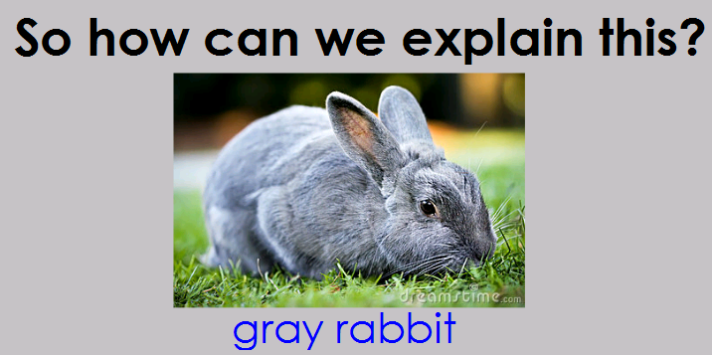

Slide 6
Non-Mendelian Genetics
Incomplete Dominance
&
Co-Dominance

Slide 7
Non-Mendelian Genetics
When Gregor Mendel studied pea plants, he happened to select traits that were determined by two alleles, where one allele was completely dominant over the other. For instance, for flower color in peas, purple flowers are dominant and white flowers are recessive. He called this the Principle of Dominance.

Slide 8
But some patterns of inheritance are different than the ones Mendel discovered. One type of inheritance is called INCOMPLETE DOMINANCE. For example, if you cross a red primrose flower with a white primrose flower, the next generation will have all pink flowers! The red and the white blend, just like mixing paint! This is when neither of the two alleles are dominant. In incomplete dominance, the phenotypes of the two alleles BLEND.

Slide 9
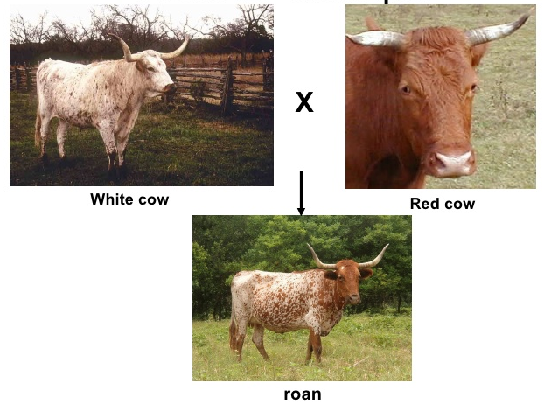
Another non-Mendelian inheritance pattern is called CODOMINANCE. In codominance, two alleles are dominant. So if an organism is heterozygous, and they inherit 2 dominant alleles, then the phenotype shows BOTH traits at the same time! For example a red cow and white cow will produce a red-and-white splotched cow, which is called roan. Both the allele for red color and the allele for white color are dominant so BOTH SHOW!

Slide 10
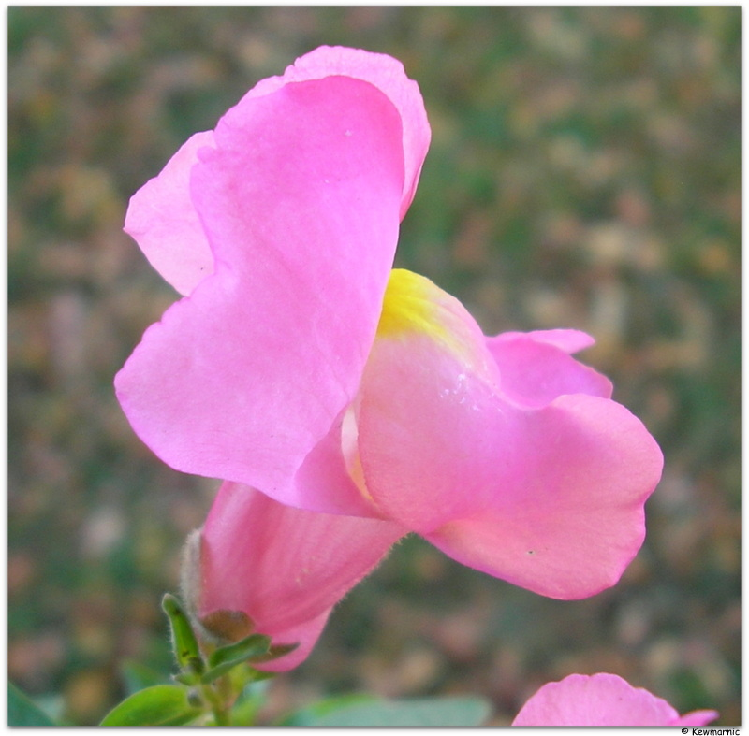
INCOMPLETE DOMINANCE
Neither
___________ allele is dominant
Incomplete = ________________________ (alleles are partially dominant)
Phenotypes _____________ or MIX
Example:
Red Flower (RR) x White Flower (WW) = ______ Flower (____)
Partial dominance
BLEND
Pink
RW

Slide 11
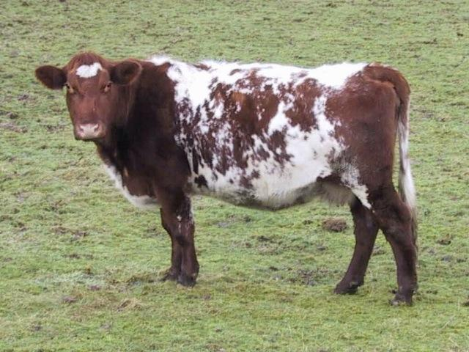
CO-DOMINANCE
BOTH
___________ alleles are equally dominant
CO = ____________
Both alleles are expressed as a third phenotype (like spots, splotches, stripes)
__________ phenotypes SHOW!
Example:
Red Cow (RR) x White Cow = _______ Cow (red-and-white splotches) (______)
BOTH SHOW
BOTH
Roan
RW

Slide 12
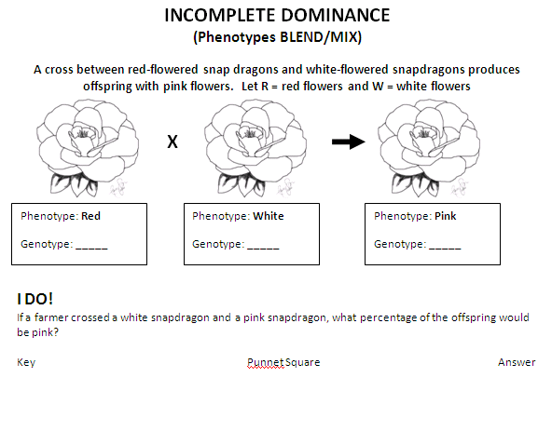

Slide 13
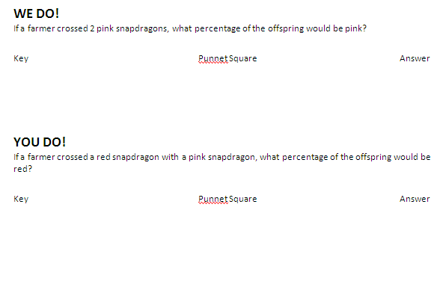

Slide 15
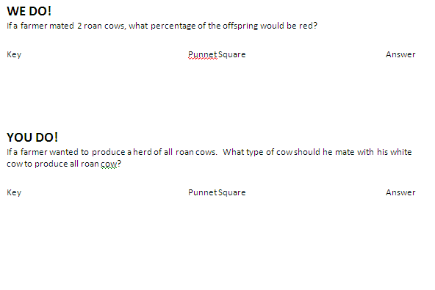

Slide 16
Independent Practice
Keep it going → BOTH sides!
Check your answers at the SSS to be sure you are getting them correct

Slide 18
