Slide 1
Genetic Engineering, Recombinant DNA, Transgenic Oranisms
Complete the Vocabulary Section
Get a green NC Coach book and complete the reading/fill-in-the-blanks
When you finish, check all your answers at the SSS!

Slide 2
VVideo: Bt Corn
While you watch, consider/answer the 3 questions on your paper.
https://www.youtube.com/watch?v=n9xpKx03g9M

Slide 3
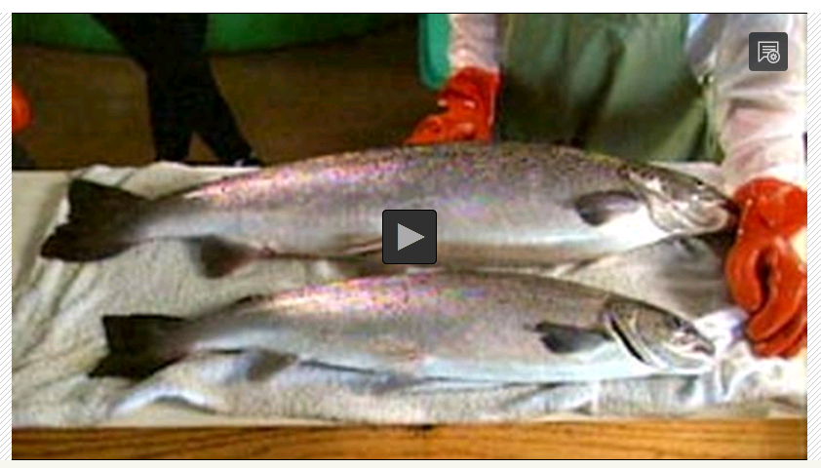
Video: Super Salmon
PBS Learning Media
As you watch, consider/answer the 4 questions on your paper

Slide 4
Practice
Complete the front side of the worksheet
When you FINISH, check your work at the SSS
Ask if you don’t understand something!

