Slide 1
Evidence
YOU watch (with Headphones) Evolution Primer #4

Slide 2
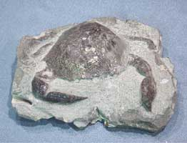
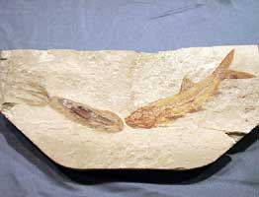
D. Evidence for Evolution
1. Fossil evidence provides an incomplete record of early life. Fossils can include any evidence of life, such as imprints and remains of organisms. This evidence must be interpreted to form an overall picture of how species have changed over time (evolved). By examining the fossil record, scientists have concluded that evolution happens in a simple to complex pattern and life emerged from sea to land. Fossils must be dated to help establish a time frame for the existence of a species. There are two methods of determining the age of fossils.
p. 136

Slide 3
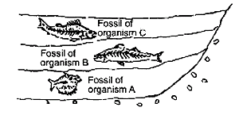
a. In relative dating the exact age of the fossil cannot be determined, only the order of appearance as compared to other fossils found in nearby rocks. Fossils occur in layers of sedimentary rock. The fossils near the top will be more recent than fossils in lower layers of rock.
b. Radioactive dating gives a more exact age using the natural decay of radioactive isotopes in organisms.

Slide 4
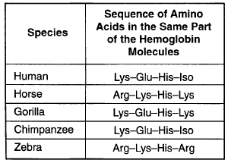
2. Biochemical similarities include comparisons of DNA and the resulting amino acid sequences for certain, shared proteins. This is considered one of the most reliable and objective types of evidence used to determine evolutionary relationships. In general, the fewer differences found between two species, the closer the evolutionary relationship.

Slide 5
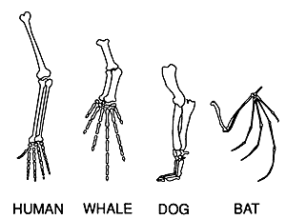
3. Shared anatomical structures supports some type of evolutionary relationship.
a. Structures with a similar bone arrangement are called homologous structures. A similar bone arrangement, even if the functions are different, supports evolution from a common ancestor.

Slide 6
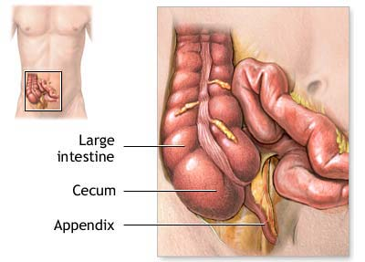
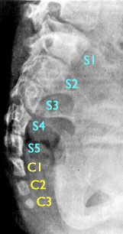
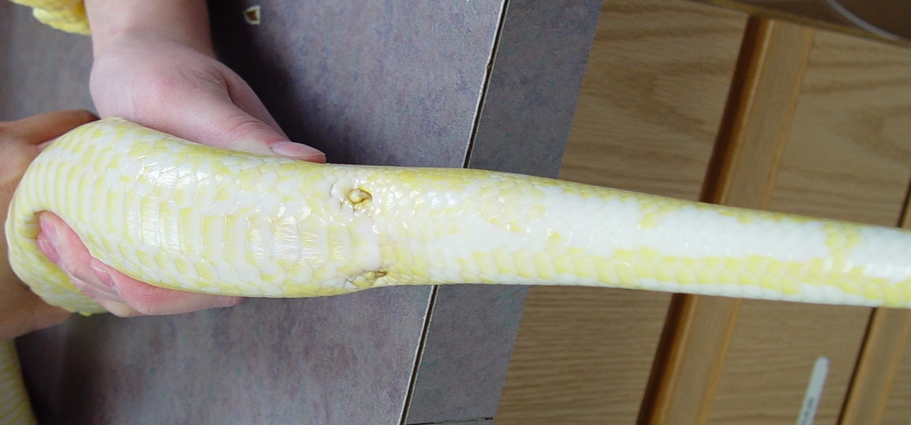
b. Structures that perform the same function (ex. flying) but are very different anatomically (ex. bird wing vs. butterfly wing) are called analogous structures. This supports evolution in similar habitats though not from a recent common ancestor.
c. Vestigial structures (ex. appendix or tail bone in human) are not functional in that organism, but may represent a link to a previous ancestor.

Slide 7
Proof of evolution that you can find on your body
https://www.youtube.com/watch?v=rFxu7NEoKC8

Slide 8
CYQ!
Answer Questions 1-3 on p. 138.

Slide 9
Videos: Darwin Presents His Case
Evolution Primer 3: How do we know evolution happens?

Slide 10
Class Work
Evidence For Evolution Worksheet …. Turn this in to be graded.
→ Watch out for V. 4 (you will need an amino acid codon chart)
Complete all Problem Solving questions in your Biology Handbook pp. 140-144 → Check your answers at the SSS when you finish

Slide 11
Natural Selection Comic Strip
Create a 4 frame comic that depicts evolution (speciation) by natural selection.
Each frame MUST be labeled with each of the 4 descriptors in the correct sequence.
Refer to the Example for how to do it.
Use your own organism and your own traits!!!
The comic must be neat and in color
Answer the questions when you are finished.
Turn it in!

