Slide 1
Enzymes
Foldable Notes

Slide 2
Foldable
Listen for directions on how to fold your Enzyme booklet.

Slide 3
Enzyme
PROTEIN that speeds up the rate of a chemical reaction
Examples:
Lactase Catalase
Lipase Pepsin
Enzyme

Slide 4
Characteristics of Enzymes
REUSABLE –unchanged during a chemical reaction; can be used over and over
CATALYST – speed up chemical reactions
SPECIFIC – bind only to certain substrates
Lower Activation Energy
Involved in Metabolism
Enzyme

Slide 5
Active Site
Active Site: area on the enzyme surface that fits the shape of the substrate.
(Where the chemical reaction occurs)
Enzyme
Active Site

Slide 6
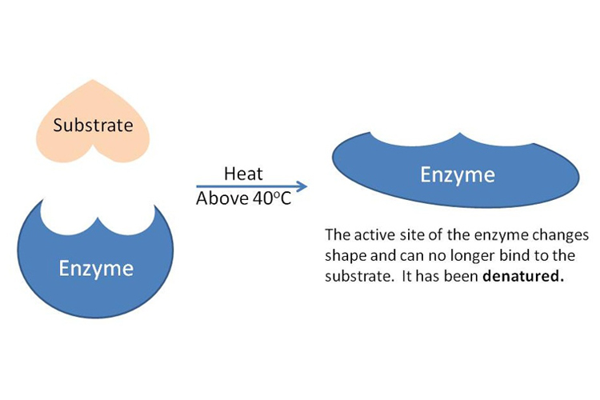
Factors that Affect how Fast an Enzyme Works
pH
Temperature
Amount of substrate
Amount of salt
Surface area of substrate
Extreme pH or temperatures change the shape of the enzyme’s active site so that the substrate won’t fit the enzyme.
When an enzyme loses its shape and stops working, it is DENATURED.

Slide 7
Activation Energy
Energy required to start a chemical reaction
Enzymes LOWER the activation energy

Slide 8
Optimal
The point where an enzyme works BEST/FASTEST
Enzymes have optimal ranges for pH and Temperature

Slide 9
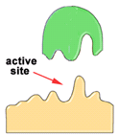
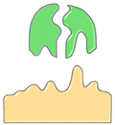
Enzyme-Substrate Complex = Lock-and-Key Model
Enzymes are specifically shaped to fit one kind of substrate. Just like 1 key fits 1 specific lock!
Reactant = what you start with (substrate)
Product = what you end with

