Slide 1
U7: Evolution
Early Earth Hypotheses
Experiments
First Cells

Slide 2
Reading Assignment
Read the Article: “Earth Without Oxygen” and write your questions and comments in the boxes as you read.

Slide 3






What was Early Earth Like?
Let’s Watch! Creating the Potential for Life
Oxygen
Sulphur
Methane (CH4)
Ammonia
Carbon Dioxide (CO₂)
Hydrogen
The Perfect “Primordial Soup”
Alternative video: “Early Earth”

Slide 4
All of the ingredients combined to create the perfect conditions for the beginning of life!
What important ingredient was NOT PRESENT on Early Earth?
What developed from this “Primordial Soup?”
Why are amino acids important for creating life?
OXYGEN
Organic molecules like amino acids
Because amino acids are the BUILDING BLOCKS of PROTEINS, which are the BUILDING BLOCKS of LIFE!

Slide 5
Experiment to show HOW life COULD HAVE began on Earth:
Stanley MILLER and Harold UREY
Their experiments showed how life may have originated on Earth
Mixed together salt water, methane gas, CO2, hydrogen, and ammonia. Added electricity to simulate ________________ and used a Bunsen burner to simulate _____________________
Created organic ________ _________ from naturally occurring gasses
He showed how the building blocks of life (amino acids) could have emerged in the absence of the gas ____________________
video Stated Clearly Miller & Urey
lightning
Heat/volcanoes/sun
Amino acids
oxygen

Slide 6
Now that we know HOW life began on early Earth, let’s figure out WHAT type of life developed…
What was the first living organism really like? Remember there was NO OXYGEN!
Prokaryotic or eukaryotic? Why? ___________________________________________________________________
Unicellular or multicellular? Why? ___________________________________________________________________
Aerobic or anaerobic? Why? ___________________________________________________________________
Autotroph or heterotroph? Why? ___________________________________________________________________
What kind of organism fits this description?
PROKARYOTES - because they are small, simple and evolved before eukaryotes
UNICELLULAR - because evolution moves from simple → complex
BACTERIA!
ANAEROBIC - there was NO OXYGEN on Early Earth
HETEROTROPHS – simple prokaryotes wouldn’t have had a chloroplast to produce their own food; they had to eat/consume molecules in the environment

Slide 7
Just Remember…
H
U
P
A
Heterotroph
Unicellular
Prokaryote
Anaerobic

Slide 8
The Evolution of Cells
Read and pay attention to the BOLD terms.
Complete the graphic organizer.
Check your answers at the SSS when you finish.
You have 15 minutes!

Slide 9
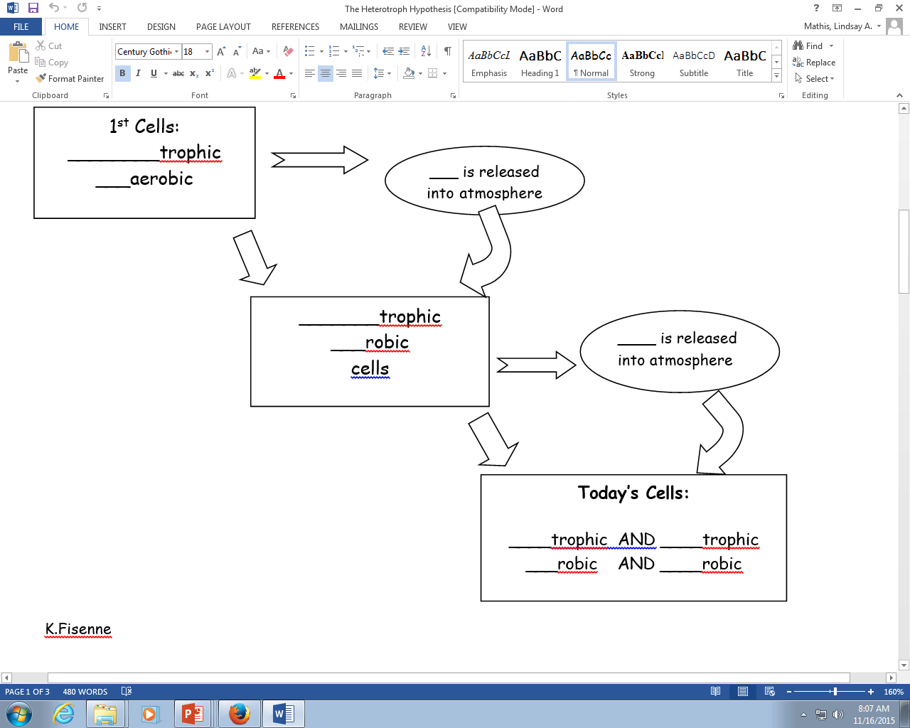

Slide 10

“The Beginning of Life”
Read the FRONT article and answer all of the questions.
Use your NOTES if you need to!

Slide 11
Early Hypotheses on How Life Began
ABIOGENESIS is the idea that life came from non-living things.
  This idea is sometimes called spontaneous generation.
  A = _______
  Bio = ________
  Genesis = ______________
Not/non
Life/living
Beginning/creation

Slide 12
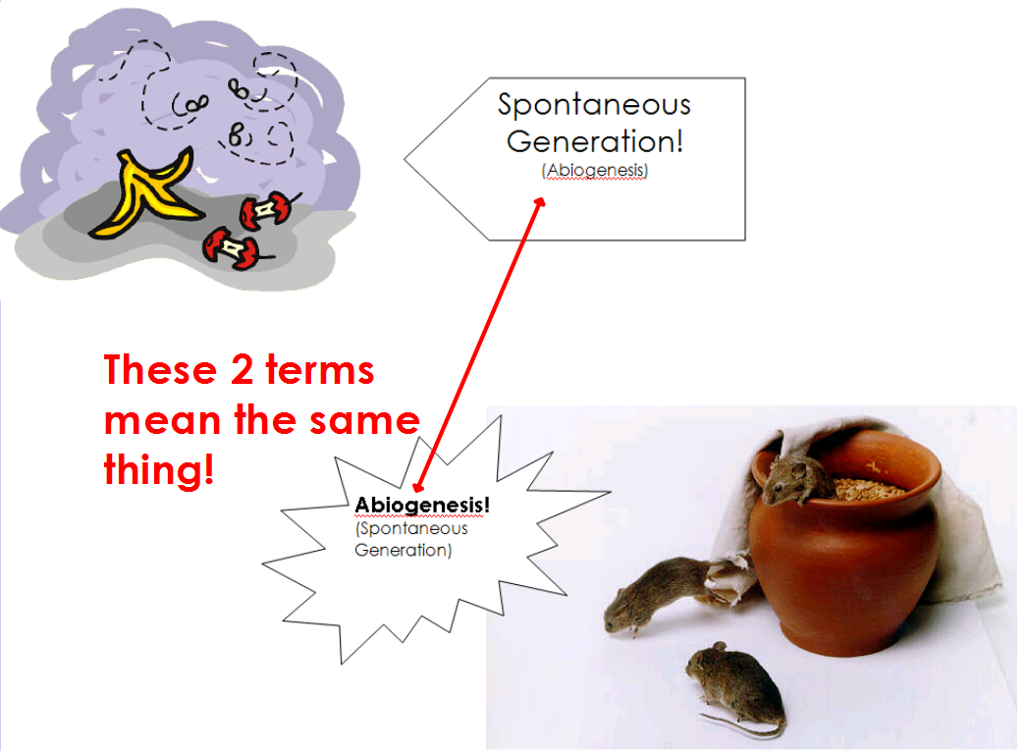

Slide 13

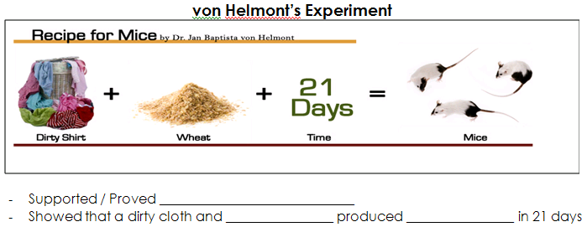
Abiogenesis/spontaneous generation
Wheat/grain
mice

Slide 14
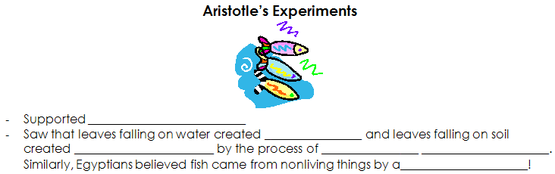
Abiogenesis
fish
Worms & insects
Spontaneous generation
Abiogenesis

Slide 15
BIOGENESIS
BIOGENESIS: the continuation of life from other ______________cells.
  Once life was established in very simple cells, biogenesis began.
  3 Scientists to performed experiments to prove biogenesis
    Francesco Redi (1688) – meat & maggots
    Spalenzani (1700s)
    Louis Pasteur (1860) – boiled broth in S-shaped flask
living

Slide 16
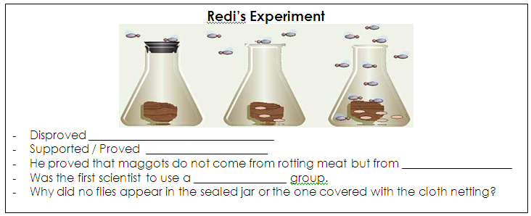
Finish reading about the 3 experiments that PROVED BIOGENESIS and fill in the notes!
Unicellular
Redi PROVED BIOGENESIS!

Slide 17
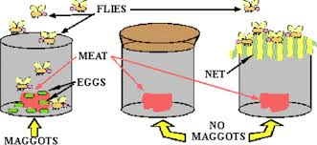
Redi’s Experiment:
Control Group Experimental Group
Independent Variable Open jars Covered jars
Constant Rotting meat Rotting meat
Observations Flies entered jars, Flies were unable to
landing on the meat enter the jar
Results Maggots developed No maggots developed
on meat on meat
Conclusions The maggots came from the flies, NOT the meat.

Slide 18
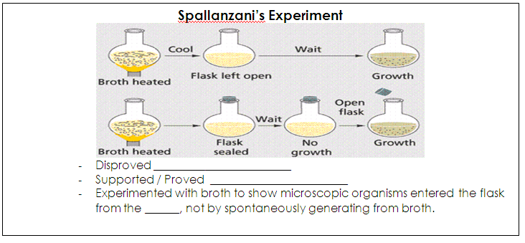
Spallanzani PROVED BIOGENESIS!

Slide 19
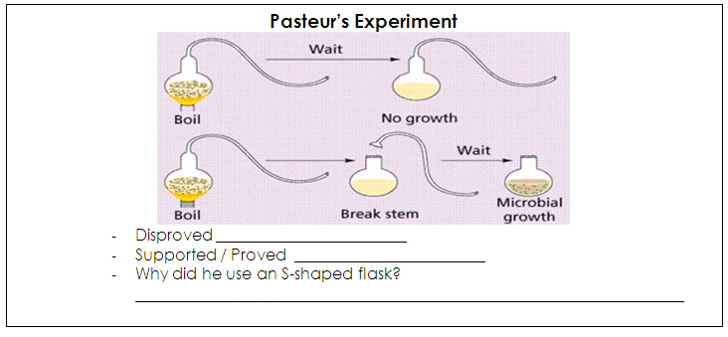
Pasteur PROVED BIOGENESIS!

Slide 20
“Theories on Origin and Change”
Read the BACK article and answer all of the questions.
Use your NOTES if you need to!
Turn in this sheet for a grade!

Slide 21
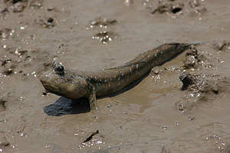
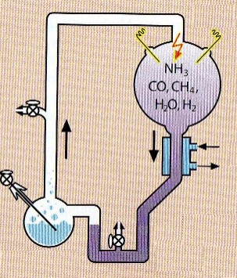
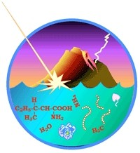
Let’s Review
You will take your OWN NOTES on paper. Pay attention to items in bold, yellow, or red!
DE: “Life as we know it”

Slide 22
Earth’s First Cells
H ___________
U ___________
P____________
A____________
The first cells would have been
Heterotrophic (must take in nutrients).
Unicellular – (single celled, simple)
Prokaryotic (no nucleus, bacteria)
Anaerobic (does not require oxygen)
Prokaryotic, heterotrophic cells are the simplest cells and therefore most likely to evolve first. The lack of free atmospheric oxygen would have required an anaerobic cell.

Slide 23
How did more complex cells arise?
Over time photosynthetic prokaryotic cells evolved, allowing for the release of free oxygen. This changed earth’s environment and led to the development of an ozone layer.
The production of oxygen led to conditions that favored the evolution of aerobic, prokaryotic cells.

Slide 24
How did more complex cells arise?
The Heterotroph Hypothesis
Oxygen!
Heterotrophic
Anaerobic
Prokaryotes
Ozone!
Photosynthetic (Autotrophic)
Anaerobic
Prokaryotes
Aerobic
Prokaryotes

Slide 25
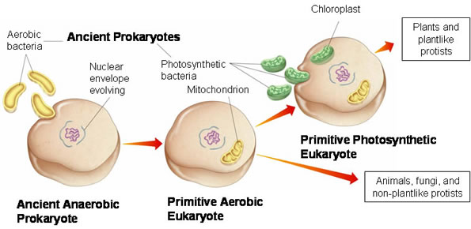
But how did EUKAROYTIC cells evolve?
Endo = “inside”
Endosymbiont Theory
Symbiosis = living closely together

Slide 26
Endosymbiont Theory
a. A variety of prokaryotic cells existed, some autotrophs and some heterotrophs
b. A larger heterotrophic cell consumed the smaller cells, using some of them for food. However, the energy harnessing power of these smaller cells could also be used by the larger cells.
c. A symbiotic relationship was formed and the smaller cells evolved into what we now know as mitochondria and chloroplasts. A nuclear envelope formed around the DNA.
YouTube - The Evolution of Eukaryotic Organisms: Endosymbiotic Theory

Slide 27
Check for Understanding
Quiz time!

