Slide 1
ANNOTATIONS

Slide 2
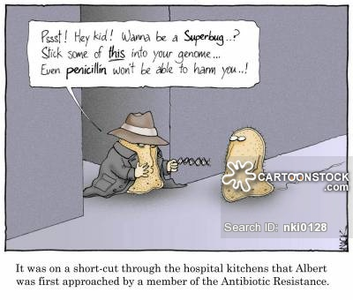
Back to those annotations!
Evolution Now: Antibiotic Resistance
Conclusions:
Some bacteria have a random gene mutation for antibiotic resistance.
Antibiotic resistance is a survival adaptation that gives some bacteria greater fitness.
Resistant bacteria survive, reproduce, & pass their resistance genes to future generations.
Eventually the majority of the population is resistant to our antibiotic drugs.

Slide 3
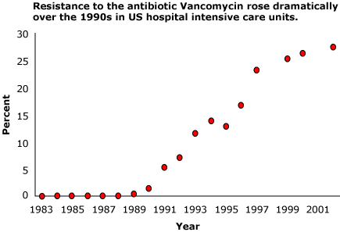
O:
C:
V:
S:
Bacteria reproduce quickly and compete for survival
Bacteria with the resistance gene/trait outcompete and survive longer against the antibiotics and reproduce
Some bacteria have gene mutations for resistance.
Resistant bacteria survive, reproduce, and pass on their antibiotic resistance genes creating a resistant population.
Conclusions:
Hospitals are a breeding ground for antibiotic resistant bacteria because there are many sick people (hosts) and antibiotics are frequently (and inappropriately) prescribed. This creates an environment that favors bacteria with resistance genes.

Slide 4
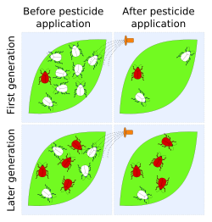
Evolution Now: Pesticide/Herbicide/Insecticide Resistance
Conclusions:
Pesticide Resistant
Dark Moths =
Light Moths =
Selective Pressure (environmental) =
Pesticide Susceptible
Overspraying of pesticides

Slide 5
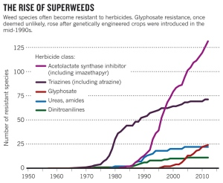
Conclusions:
Increased use of herbicides and GMO crops that produce herbicides have selected for the evolution of more herbicide resistant weeds.
What should farmers do?

Slide 6
III. Does evolution still happen today?
A. As long as variation, overproduction, competition, natural selection and mutations occur, evolution will occur. Because evolution leading to speciation happens over such a long period of time, speciation is not readily observable within a lab.
B. Natural selection, one of the main mechanisms of evolution, is observable in some populations. For example, the evolution of resistance to chemicals:
p. 138
Amoeba Sisters: Natural Selection and the Bacterial Resistance

Slide 7
1. Farmers use pesticides to eliminate insects. In a population of insects, some individuals will possess genetic immunity to certain chemicals. When the chemicals are applied, the individuals with genetic immunity will survive and reproduce, passing this resistance to the next generation of offspring. Over time, more individuals are born with this immunity, rendering the pesticide useless.
This is EVOLUTION!

Slide 8
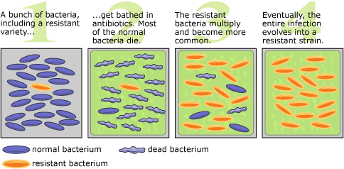
2. Antibiotics are drugs that fight bacterial infections. Within any population there is genetic variation. In the case of antibiotic resistance, some bacteria are genetically more resistant to the antibiotic than other bacteria. If the amount of antibiotic delivered is too low or the full course not completed, only those least resistant will die. The surviving, resistant bacteria will reproduce. With future applications of antibiotics the population is selected to become more and more resistant. The overuse of antibiotics has led to many resistant strains of bacteria.
p. 139
Video: Evolving Ideas: Why does evolution matter now? (PBS Learning Media

