Slide 1
ANIMALS…Fast and furious!
FA

Slide 2
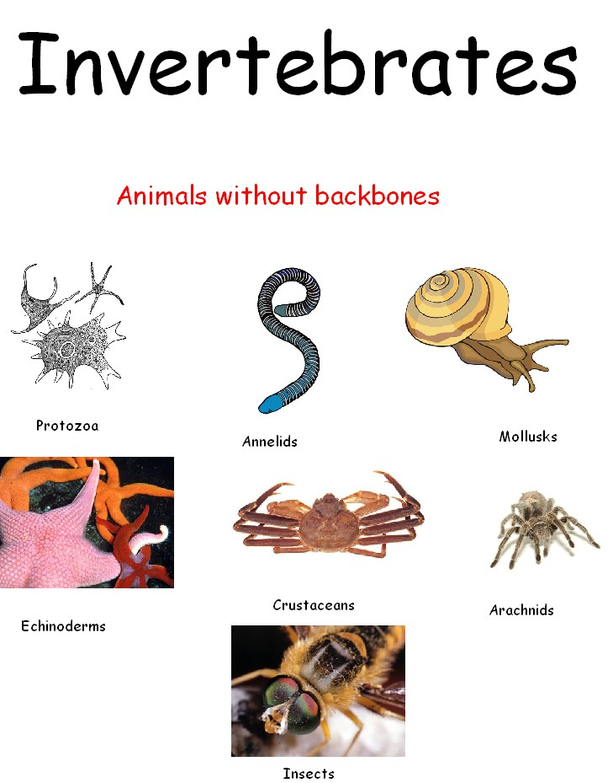
Observing invertebrates and vertebrates

Slide 3
Animal characteristics:
Multicellular, eukaryotic, heterotrophic
2 groups: invertebrates (no backbone) & vertebrates (have a backbone)

Slide 4
Synthesis
Protein Synthesis: occurs in ribosomes
DNA→ RNA → protein
proteins are used for structures such as muscle fiber, enzymes, hormones, and pigments.
Lipid Synthesis: Phospholipids in cell membranes

Slide 5
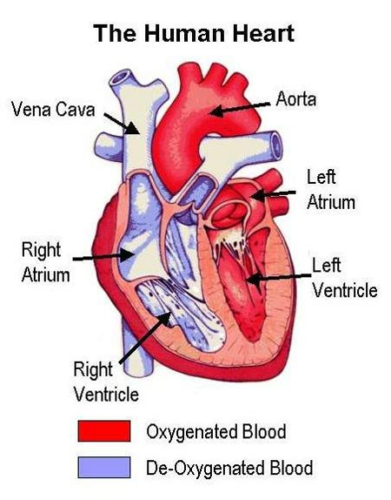
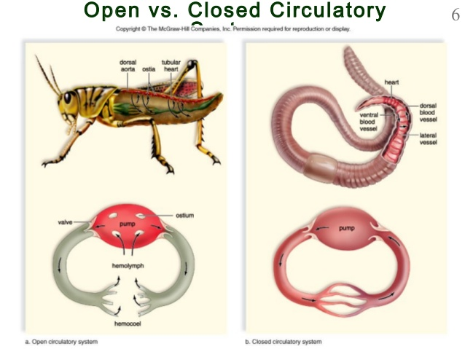
TRansport
OPEN
CLOSED
BLOOD: carry nutrients & oxygen to cells & waste products away
Open vs Closed:
open circulatory system, the blood flows freely in a body cavity where it makes direct contact with internal organs.
closed circulatory system blood is enclosed in vessels such as arteries and veins.
4 chambered heart: separates oxygenated & deoxygenated blood; mammals only

Slide 6
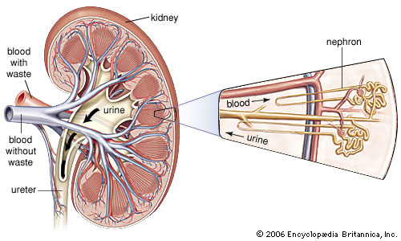
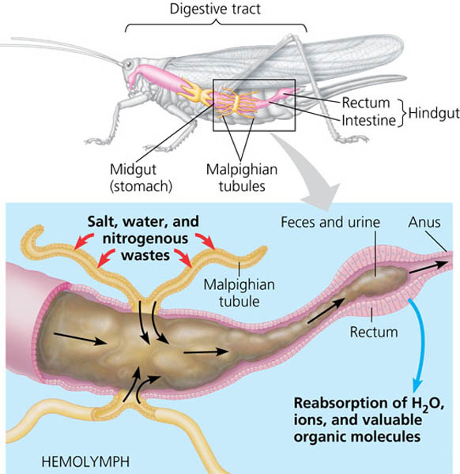
Excretion
Nepridia / Malpighian tubules:
nephridia in annelid worms
Malphigian tubules in insects
specialized excretory structures in some body segments to filter and remove waste from the blood
Kidneys: made up of smaller parts called nephrons to filter wastes from the blood.

Slide 7
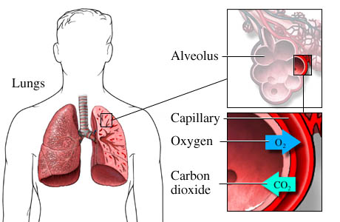
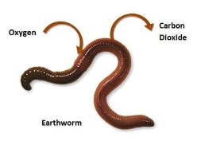
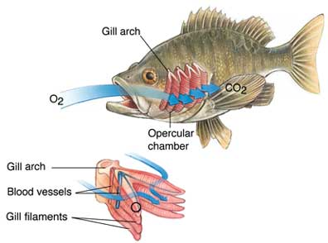
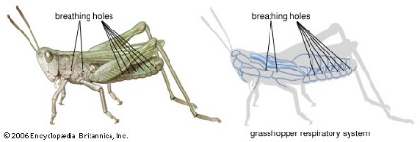
Respiration
Skin: in worms, oxygen is able to diffuse through moist skin and enter the bloodstream.
Spiracles: tiny pores in insects that take in oxygen
Gills: thin membranes that allow the exchange of oxygen from the water into the bloodstream.
Lungs: Contain alveoli (small air sacs that allow for fast diffusion of oxygen into blood and carbon dioxide out of blood).

Slide 8
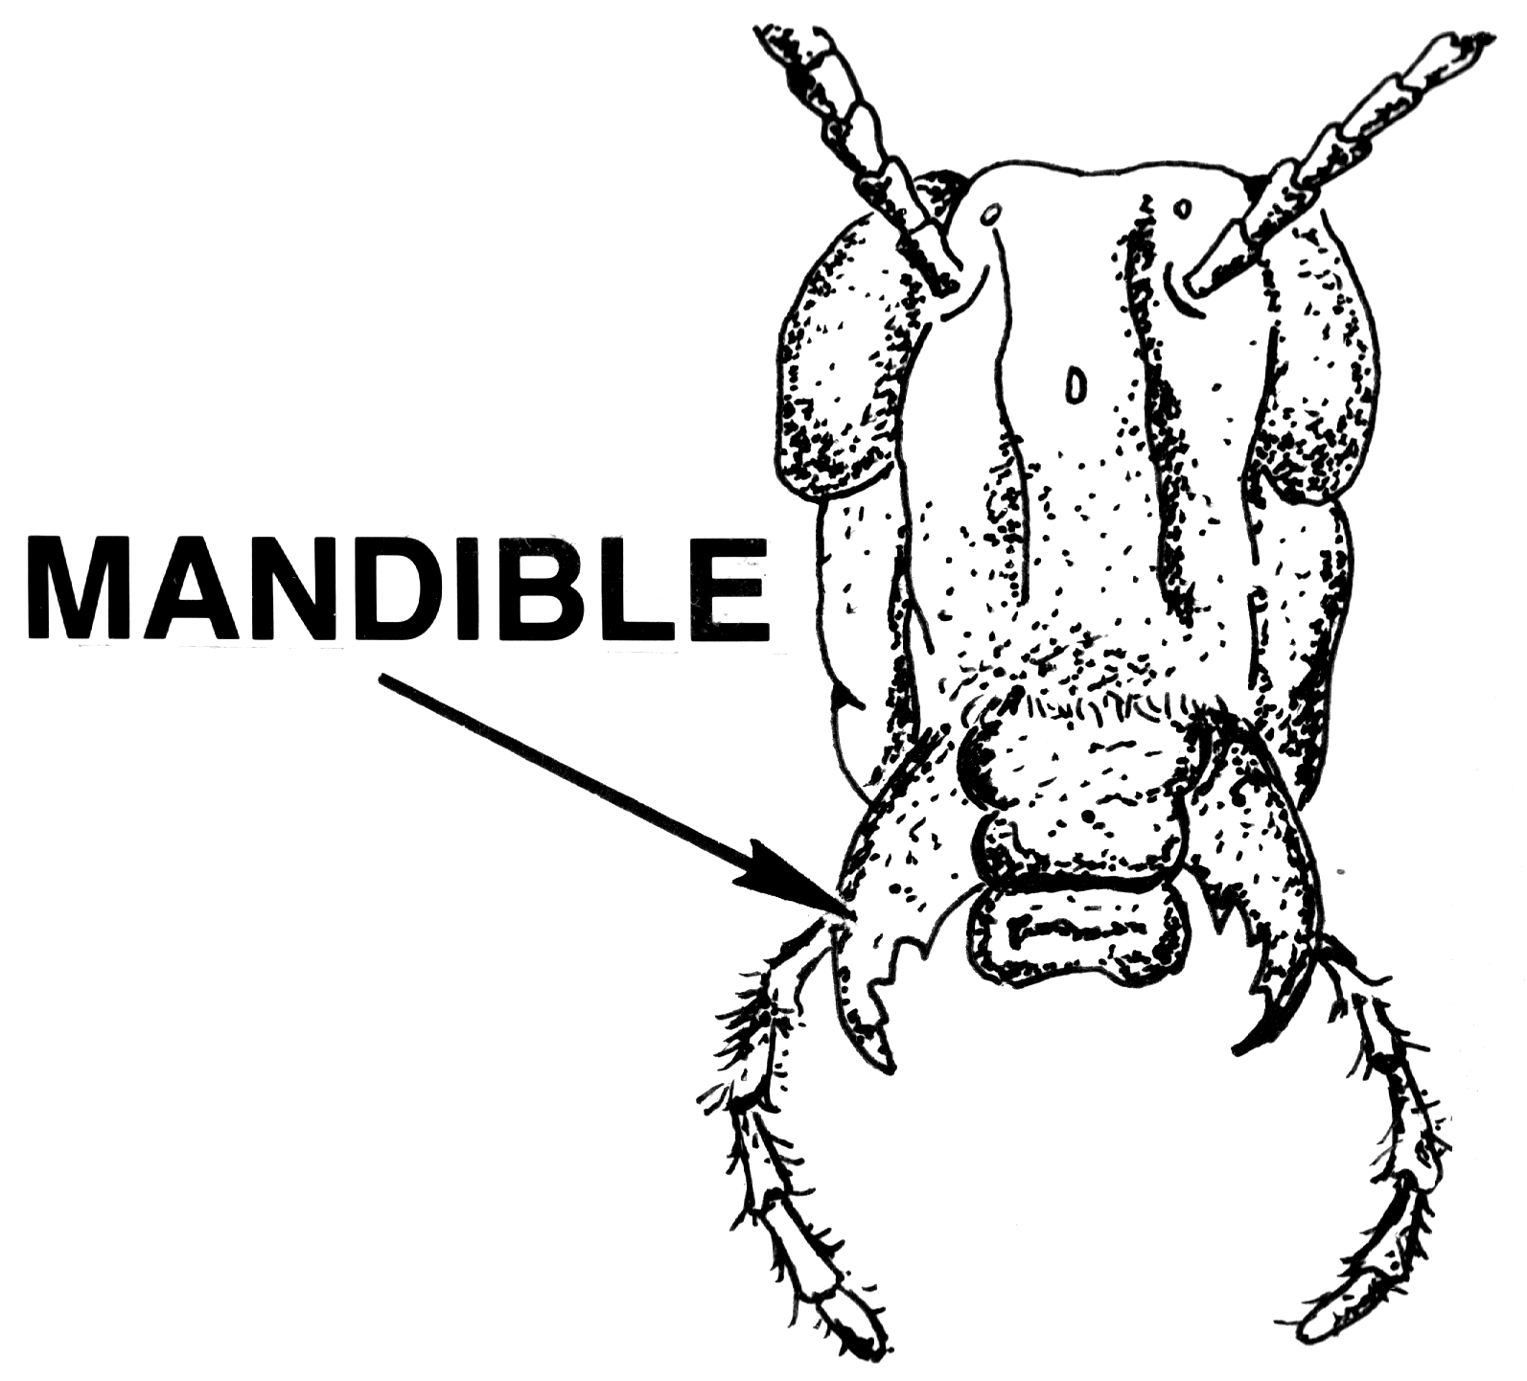
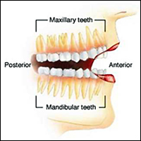
Nutrition
Mandibles / Teeth: chewing mouth parts found in insects; specialized teeth in vertebrates

Slide 9
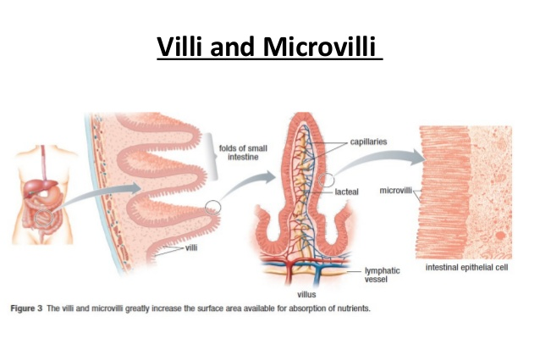
Nutrition
Digestive tract: intestinal lining contains finger-like projections called microvilli to increase the surface area and allow for more efficient nutrient absorption.

Slide 10
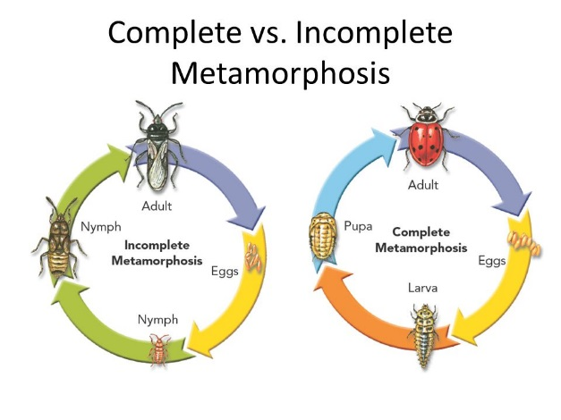
Growth and Development
Eggs: Metamorphosis:
INCOMPLETE METAMORPHOSIS
COMPLETE METAMORPHOSIS
3 Stages:
egg → nymph → adult
Nymph stage is smaller version of the adult
4 Stages:
egg → larva → pupa → adult
Each stage is very different from the one before it; it is a complete change

Slide 11
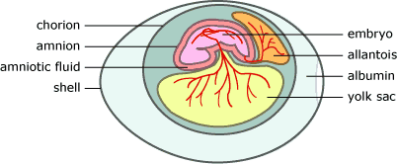
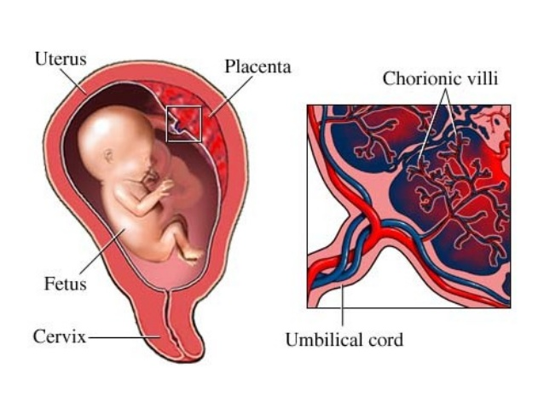
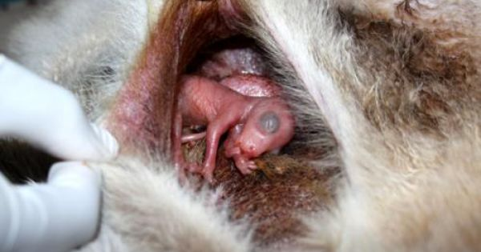
Growth and Development
Amniotic egg: contains yolk, providing a food source for the developing embryo
Pouch: marsupials born immature and continue developing in mothers pouch
Placenta: connects embryo/fetus to mother’s circulatory system

Slide 12
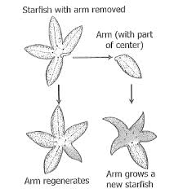
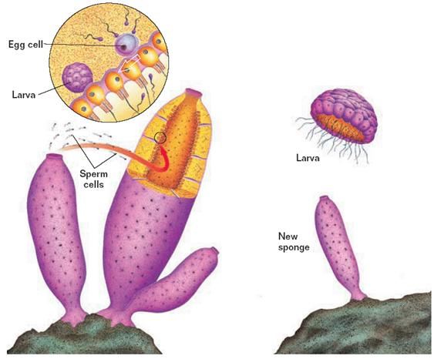
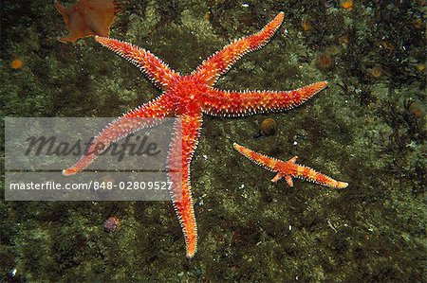
Reproduction
Asexual:
fragmentation in sponges
regeneration in starfish

Slide 13
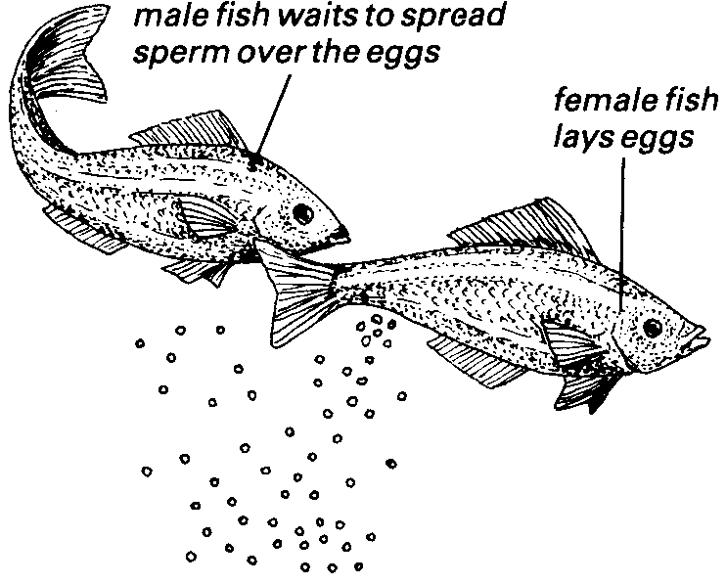
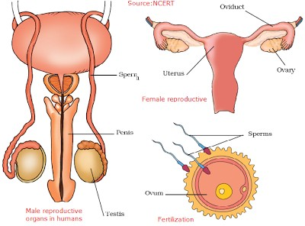
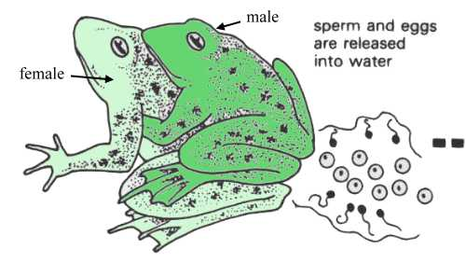
Reproduction
Sexual:
External fertilization: females lay eggs and males deposit sperm to fertilize outside of female’s body; usually in water (fish, amphibians)
Internal fertilization: male places sperm inside of female’s body (used by most land animals)

Slide 14
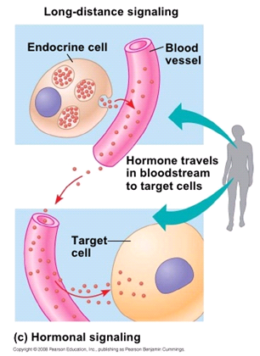
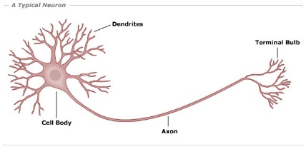
Regulation
Nervous system:
Neuron is basic unit of nervous system
Shaped to be specialized for sending and receiving both electrical and chemical messages.
Hormones:
respond to stimuli & regulate body systems
Travel through the circulatory system as a form of long distance communication between cells

