Slide 1
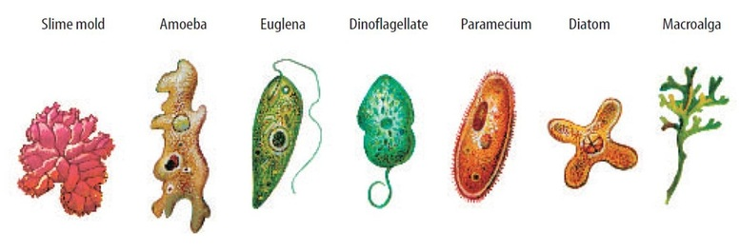
Kingdom: PROTISTA
Remember, protists are
EUKARYOTIC
UNICELLULAR

Slide 2
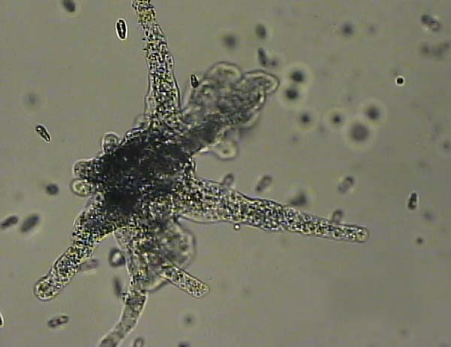
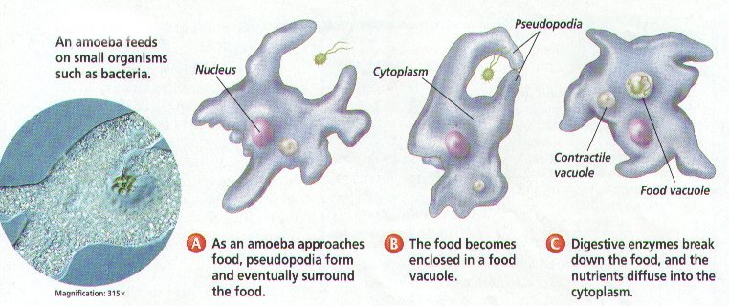
Amoeba (animal-like protist)

Slide 3
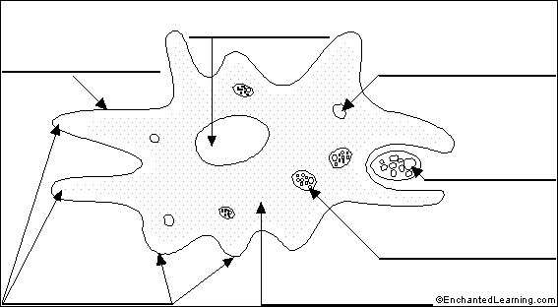
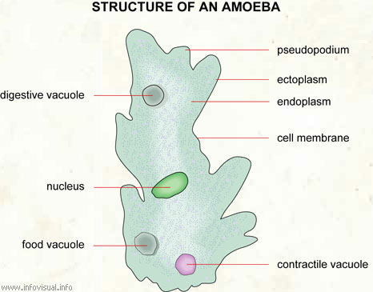
Amoeba
Label: Nucleus, cell membrane, food being engulfed, pseudopods, food vacuole, nucleus

Slide 4
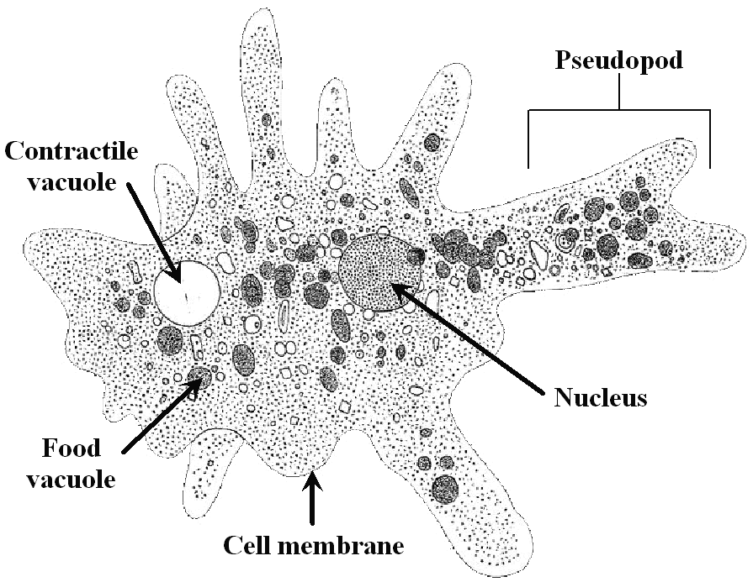
STERNGRR/ ADAPTATIONS: Amoeba
MOVEMENT
Uses pseudopods: “false feet” or projection of cytoplasm that allows the protist to “walk”/move and engulf food

Slide 5
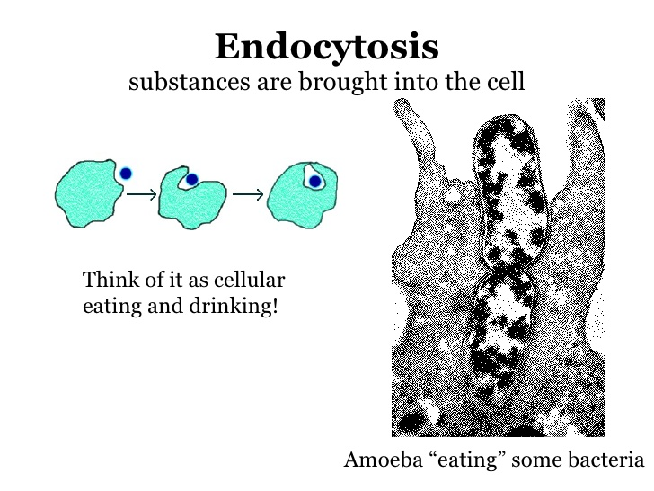
STERNGRR/ ADAPTATIONS: Amoeba
NUTRITION
An amoeba engulfs its food and forms a food vacuole. Digestive enzymes then break the food down into smaller organic compounds to be absorbed. It’s called endocytosis.
Amoeba eats two paramecia

Slide 6
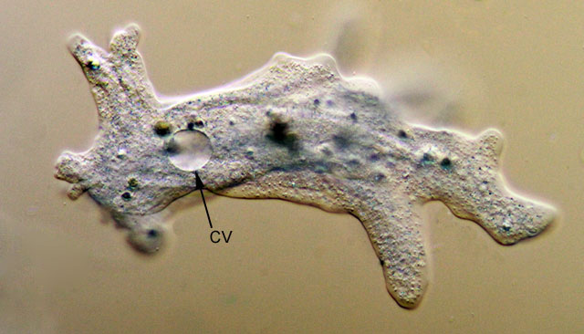
STERNGRR/ ADAPTATIONS: Amoeba
REGULATION
(HOMEOSTASIS)
contractile vacuole to regulate water balance
Cell membrane to regulate materials entering and leaving the cell.

Slide 7
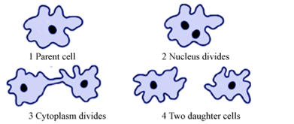
STERNGRR/ ADAPTATIONS: Amoeba
REPRODUCTION
Divide ASEXUALLY through mitosis or binary fission.
Watch it!

Slide 8
REFLECT
Is the amoeba an autotroph or a heterotroph? How do you know?
Is the amoeba more plant-like, animal-like, or fungus-like? Explain.

Slide 9
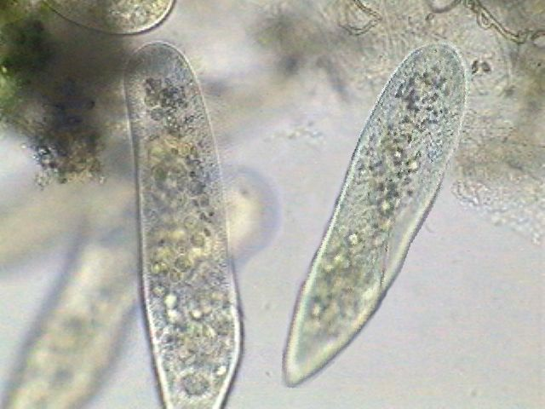
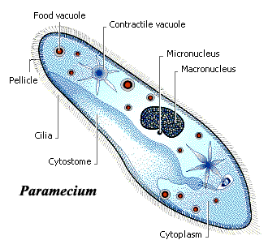
Paramecium (animal-like protist)

Slide 10
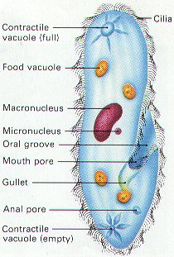
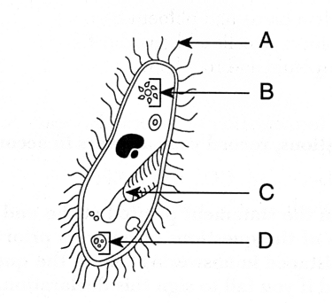
Paramecium
Label: Oral groove, food vacuole, contractile vacuole, cilia

Slide 11
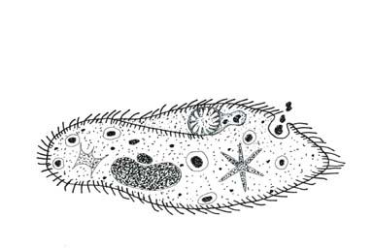
STERNGRR/ ADAPTATIONS: Paramecium
MOVEMENT
Uses cilia: small hair-like projections used for locomotion
Watch it!

Slide 12
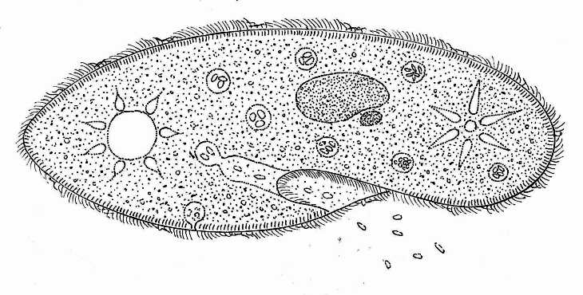
STERNGRR/ ADAPTATIONS: Paramecium
NUTRITION
The paramecium uses cilia to sweep food into its oral groove and into food vacuoles. These then combine with specialized organelles called lysosomes that contain digestive enzymes to break down compounds.

Slide 13
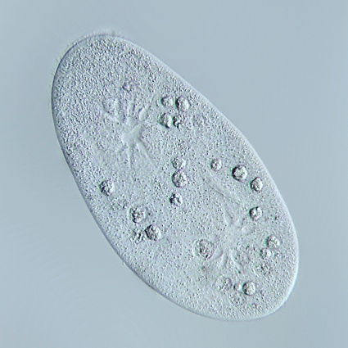
STERNGRR/ ADAPTATIONS: Paramecium
REGULATION
(HOMEOSTASIS)
contractile vacuole to regulate water balance
Cell membrane to regulate materials entering and leaving the cell.
Let’s Watch: Paramecium Vacuole

Slide 14
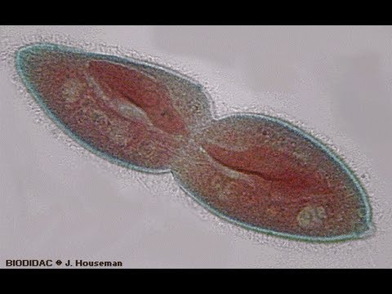
STERNGRR/ ADAPTATIONS: Paramecium
REPRODUCTION
Divide ASEXUALLY through mitosis or binary fission.

Slide 15
REFLECT
Is the paramecium an autotroph or a heterotroph? How do you know?
Is the paramecium more plant-like, animal-like, or fungus-like? Explain.

Slide 16
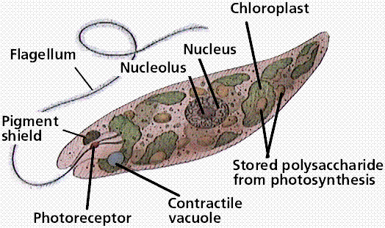
Euglena (plant-like protist)

Slide 17
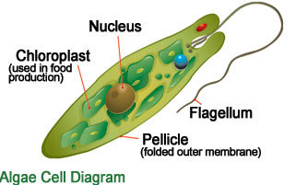
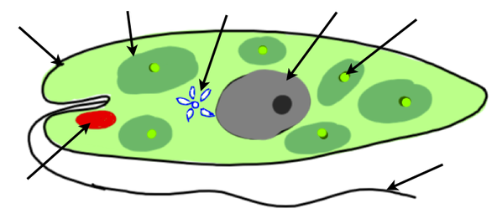
Euglena
Label: Nucleus, Eye spot, Cell Membrane, Flagellum, Contractile Vacuole, Chloroplast, Chlorophyll

Slide 18
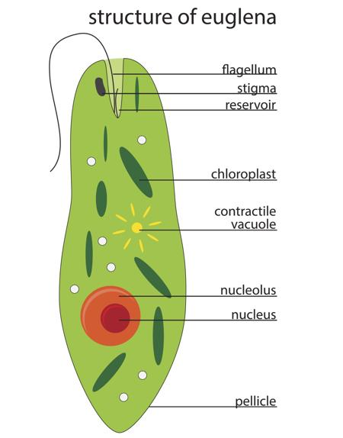
STERNGRR/ ADAPTATIONS: Euglena
MOVEMENT
Uses flagella: tail-like projections used for locomotion
Watch it!

Slide 19
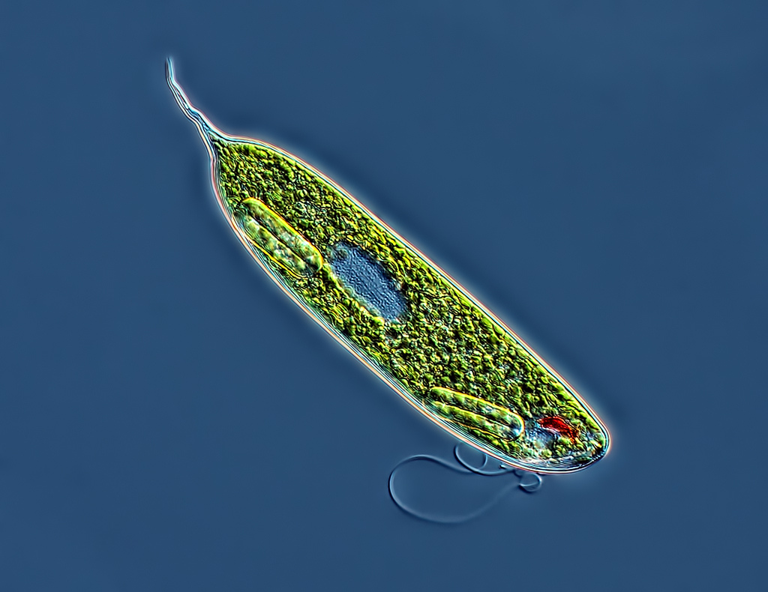
STERNGRR/ ADAPTATIONS: Euglena
NUTRITION
Algae obtain nutrients by converting sunlight energy into food using chlorophyll pigment inside chloroplasts.
They also have an eye spot to locate sunlight.
The movement of a protist in response to light stimuli is called photo-taxis.

Slide 20
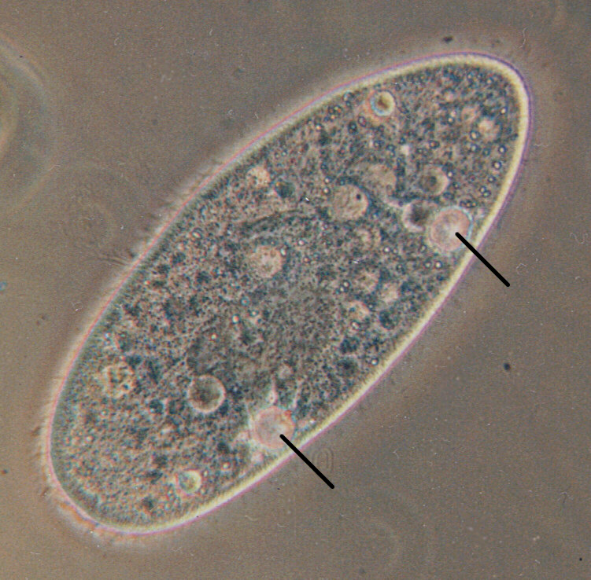
STERNGRR/ ADAPTATIONS: Euglena
REGULATION
(HOMEOSTASIS)
contractile vacuole to regulate water balance
Cell membrane to regulate materials entering and leaving the cell.

Slide 21
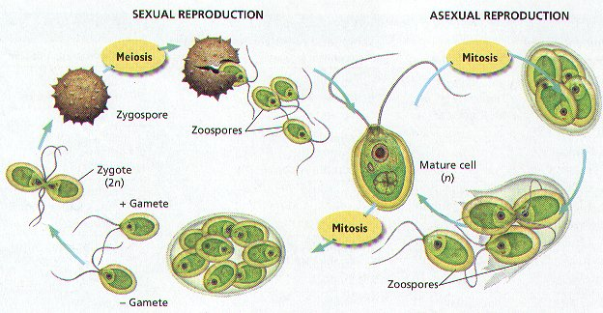
STERNGRR/ ADAPTATIONS: Euglena
REPRODUCTION
Divide ASEXUALLY through mitosis or binary fission.
Reproduce SEXUALLY by conjugation (swapping genes) or spores.

Slide 22
REFLECT
Is the paramecium an autotroph or a heterotroph? How do you know?
Is the paramecium more plant-like, animal-like, or fungus-like? Explain.
How is the eye spot an adaptation for survival in paramecium?

Slide 23
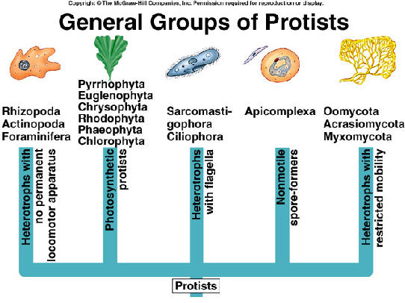
PRACTICE!
Complete the practice questions on the last page.

Slide 24
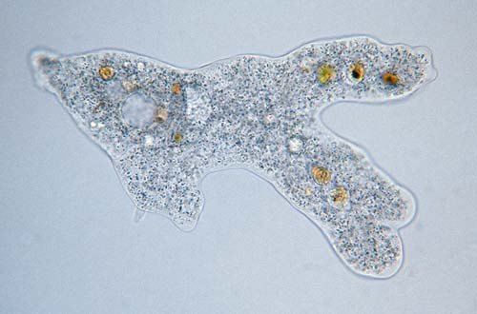
Protista Identification Using a Dichotomous Key
Amoeba

Slide 25
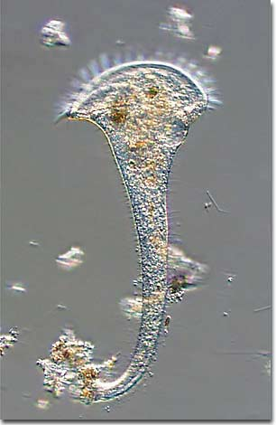
Protista Identification Using a Dichotomous Key
Stentor

Slide 26
Protista Identification Using a Dichotomous Key
Euglena

Slide 27
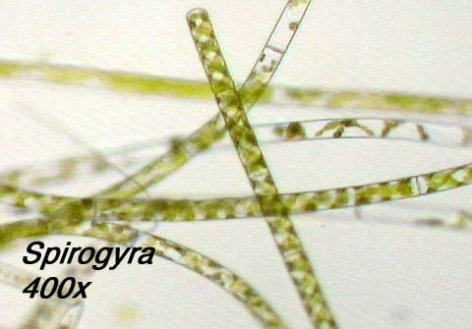
Protista Identification Using a Dichotomous Key
Spirogyra

Slide 28
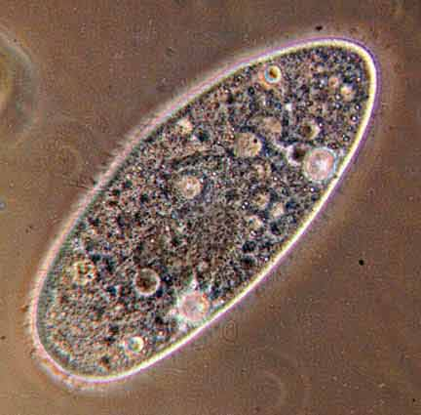
Protista Identification Using a Dichotomous Key
Paramecium

Slide 29
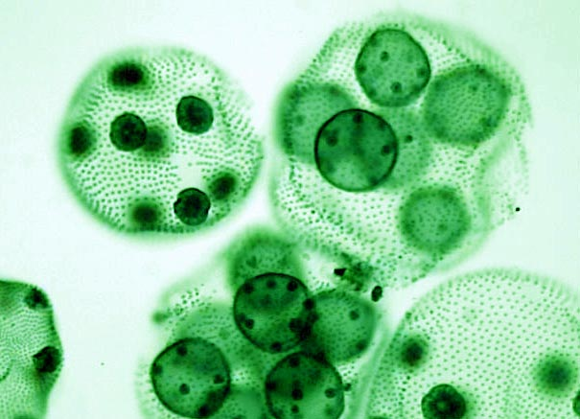
Protista Identification Using a Dichotomous Key
Volvox

