Slide 1
Unit 1 Continued
Characteristics and Processes of Life

Slide 2
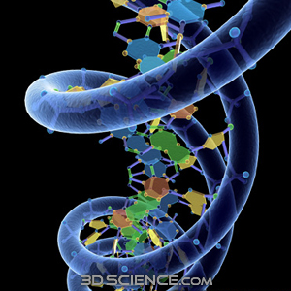
Life Characteristic #1
Genetic Code: All living things are made from a universal
Genetic code (DNA, RNA)
This is also known as
heredity.

Slide 3
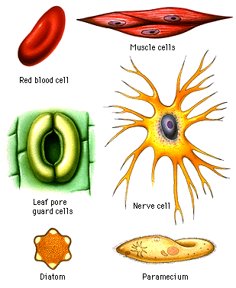
Life Characteristic #2
All living things are made up of one or more cells.

Slide 4
Life Characteristic #3
Living things can obtain and use energy.
This is also called METABOLISM

Slide 5
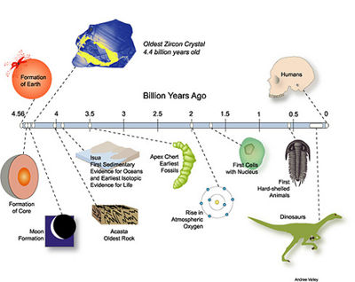
Life Characteristic #4
change over time a population. (They evolve)

Slide 6
Life Characteristic #5
Living things are able to maintain homeostasis. (internal balance)(Regulation)
Definition:
The ability to maintain a stable (balanced)
internal environment

Slide 7
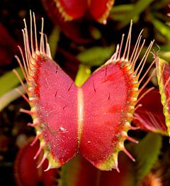
Life Characteristic #6
Living things are able to adapt or respond (adjust) to their environment.

Slide 8
STERNGRR Stations
Circulate through all 8 Life Processes Stations and answer the questions on your sheet as you go.
There are 2 copies of EACH station sheet so SPREAD OUT!
Do NOT copy answers from your classmates.
You should READ the information yourself and generate your OWN ANSWERS.
You have 35 minutes.

Slide 9
Assignment: STERNGRR
Create a poster for the 8 Life Processes (STERNGRR).
Include:
The life process term (1 pt)
An image/drawing to represent the life process (1 pt)
A definition of what the process is (in simple terms)(1pt)
Be sure to:
Keep it colorful and easy to read (1 pt)

Slide 10
Assignment: STERNGRR
You will be graded on:
The poster you create (for content and appearance)
25 pts total
Sample format below
Synthesis | Transport | Excretion | Respiration
Nutrition | Growth | Reproduction | Regulation

Slide 11
Scientific Method Problem Solving Set – HB p. 9
Answer questions 20-33
Check your answers at the SSS when you finish.

