Slide 1
Adaptations Increase Fitness!

Slide 2
Quick Notes
Living things that are well adapted to their environment survive and reproduce.
Those that are not well adapted don’t survive and reproduce.
An adaptation is any characteristic that increases fitness.
Fitness is the ability to survive and reproduce.

Slide 3
Adaptations
In the example of the finches, there was clear evidence of genetic variation because ____________________________________________________________________________. These differences had to be passed on (in the _____________) from one generation to the next. Sometimes these variations are beneficial (advantageous). These helpful variations are called _____________. How do these adaptations (+ changes in DNA) occur? Sometimes through ____________. Other times, mutations are harmful, such as in the example of ______ ____ disease. Genetic variation can also occur through __________ shuffeling.
Genes (DNA)
adaptations
mutations
Sickle cell
gene

Slide 4
Fitness
The finch example also demonstrates the concept of fitness. Fitness is the ability of an organism to ___________ and ______________ offspring that can also survive and reproduce. Hence the phrase “survival of the fittest”.
survive
reproduce

Slide 5
Which lion has greatest fitness? (most fit)
Name | George | Dwayne | Spot | Tyrone
Age at death | 13 years | 16 years | 12 years | 10 years
# cubs fathered | 19 | 25 | 20 | 20
# cubs surviving to adulthood | 15 | 14 | 14 | 19
Size | 10 feet | 8.5 feet | 9 feet | 9 feet

Slide 6
Why?
Suppose that Tyrone had genes that he passed on to his cubs that helped his cubs to resist infections, so they were more likely to survive to adulthood. These genes would be more common in the next generation, since more of the cubs with these genes would survive to reproduce. A characteristic which is influenced by genes and passed from parents to offspring is called heritable.
Over many generations heritable adaptive characteristics become more common in a population. This process is called evolution by ___________ ___________. Evolution by natural selection takes place over many, many generations.
Natural selection

Slide 7
Mechanisms for Evolution

Slide 8
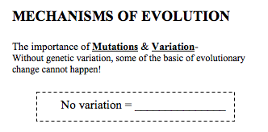
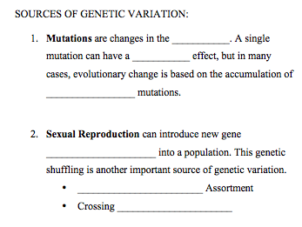
NO EVOLUTION!!!
DNA
NEGATIVE
CROSSING OVER
MANY
COMBINATIONS
CREATES GENETIC VARIATION
INDEPENDENT
OVER

Slide 9
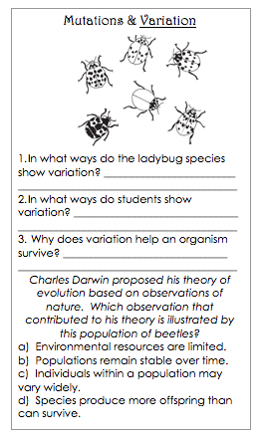
Variation is NECESSARY for Evolution…
Different Phenotypes (appearances)
Different Phenotypes (appearances) and work ethic…etc.
Creates difference in traits. Some have better traits for the environment than others. These individuals are more successful at reproducing.

Slide 10
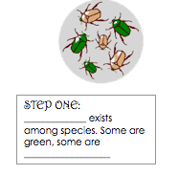
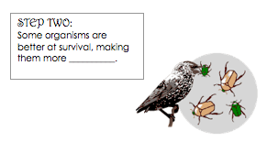
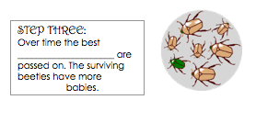
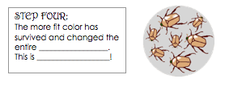
How nature picks the “fittest” organisms: Natural Selection
FIT
VARIATION
BROWN
TRAITS
POPULATION
NATURAL SELECTION (EVOLUTION)

Slide 11
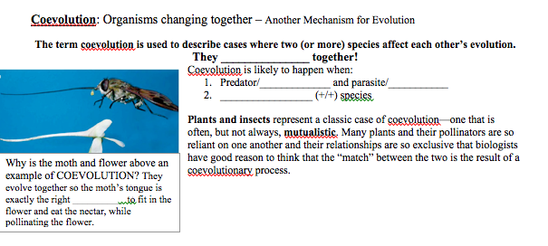
CO-EVOLUTION
EVOLVE
PREY
HOST
SYMBIOTIC
MUTUALISM
SHAPE

Slide 12
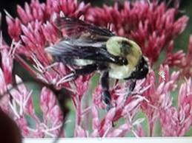
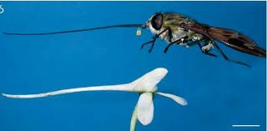
Co-Evolution
JOINT
INFLUENCES
SYMBIOTIC

Slide 13
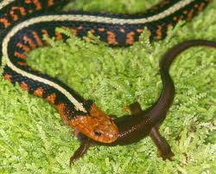
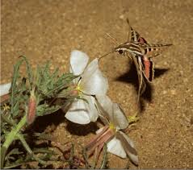
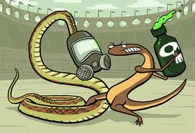
SHAPE
CHEMICALS
RESISTANT

Slide 14
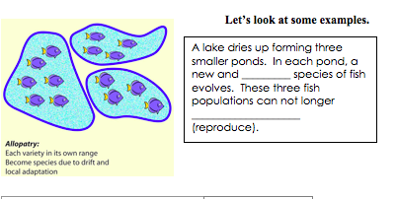
Geographic Isolation
Group of organisms that can mate and produce fertile offspring
DIVIDE / SEPARATE
MOUNTAINS, LAKES, RIVERS, OCEANS, and ISLANDS
NEW / SEPARATE
SEPARATE
GEOGRAPHIC
ISOLATION
DIFFERENT
MATE and produce FERTILE OFFSPRING

Slide 15
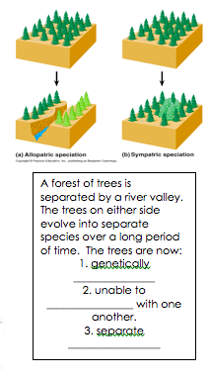
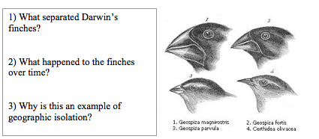
Examples of Geographic Isolation
The ocean – different Islands
Beak shape changed, due to the different food sources on each island
DIFFERENT
REPRODUCE/MATE
The finches were physically separated
The environments were different
This means the best adaptations differed by island
Over time the populations began to look like the best adapted.
SPECIES

Slide 16
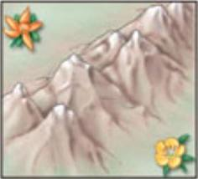
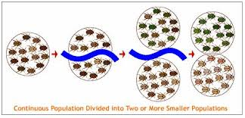
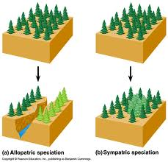
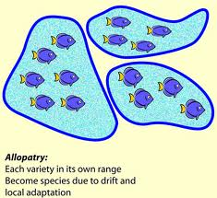
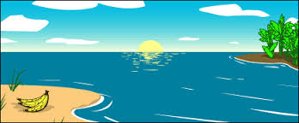
GEOGRAPHIC ISOLATION
RIVERS
MOUNTAINS
LAKES
ISLANDS

Slide 17
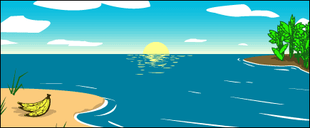
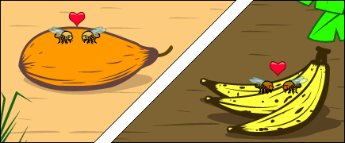
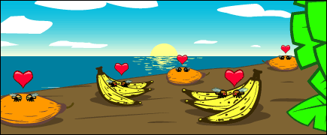
Isolation Leads to a new species…
Geographic Isolation can physically separate organisms, but they need to stop reproducing to create new organisms.
The different environments can create different cultures among the organisms.
GEOGRAPHIC ISOLATION
Let’s say and island was created, creating geographic isolation between a species of fruit flies.
The island support different fruit than the mainland (mangos vs. bananas)
This difference in fruit led to difference food preferences for the fruit flies on the mainland vs. the island.
Let’s say the fruit flies mate by hanging out near their fruit of preference.
Over time the island flies would mate near bananas and the mainland flies would mate near mangos.
The mainland flies and island flies would stop mating because of the mating culture around their preferred food.
Gene flow (sharing genes) between the two groups of fruit flies would stop, until their genes were so different they could no longer reproduce together.
Thus, forming a NEW SPECIES of fruit flies.
REPRODUCTIVE ISOLATION

Slide 18
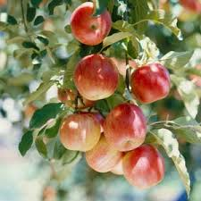
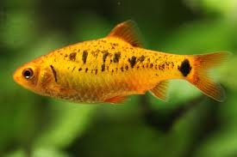
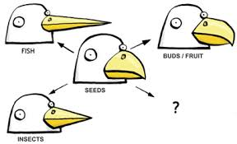
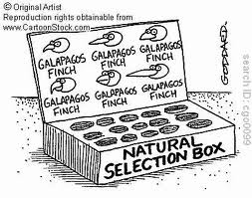
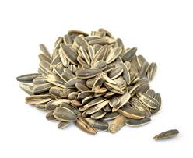
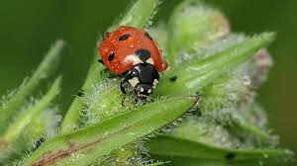
DECIDES
ORGANISM

Slide 19
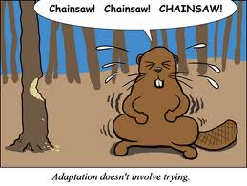
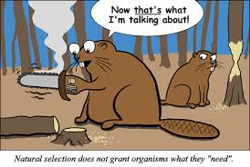
Just to make sure…
ORGANISMS DO NOT CHOOSE SUCCESSFUL TRAITS!!!!
THE ENVIRONMENT SELECTS WHICH TRAITS BENEFIT THE ORGANISM FOR THE ENVIRONMENT THEY ARE IN!

Slide 20
Patterns of Natural Selection
FAVORS the middle phenotype

Slide 21
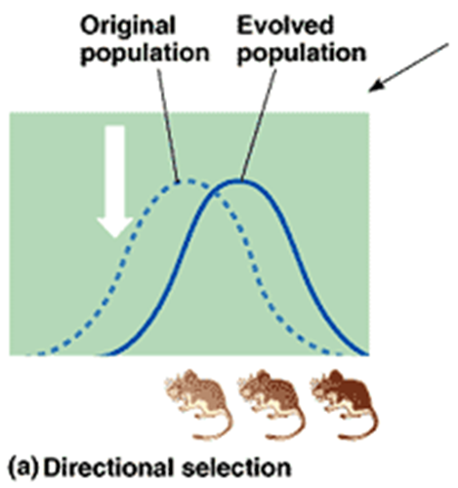
Patterns of Natural Selection
FAVORS one extreme phenotype

Slide 22
Patterns of Natural Selection
FAVORS both extreme phenotypes

Slide 23
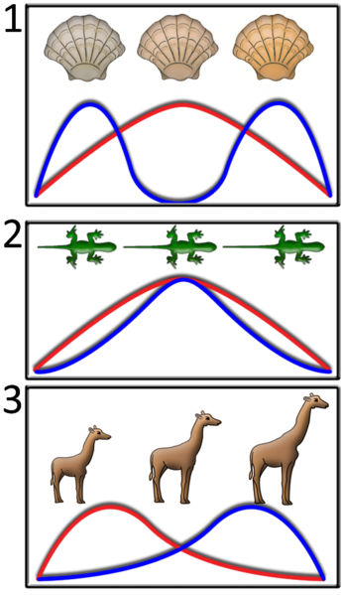
PRACTICE
Identify each type of selection below.
Propose a possible reason (selective pressure) for the pattern/scenario.

Slide 24
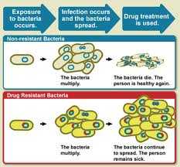
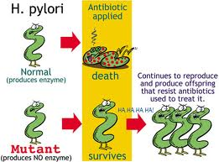
Current Examples of Evolution…
ANTIBIOTICS
DON’T DIE
VIDEO CLIPS:
http://www.youtube.com/watch?v=ivpsnKU9U1g
http://www.youtube.com/watch?v=zjR6L38yReE

Slide 25
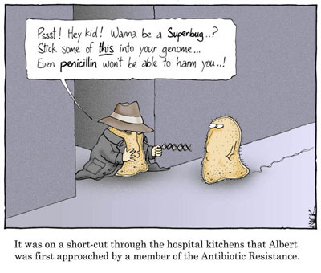

Slide 26
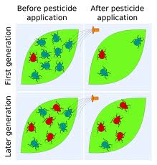
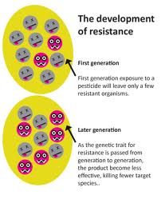
INSECTS
RESISTANCE
DDT

Slide 27
Practice EOC Question

